Slide 1
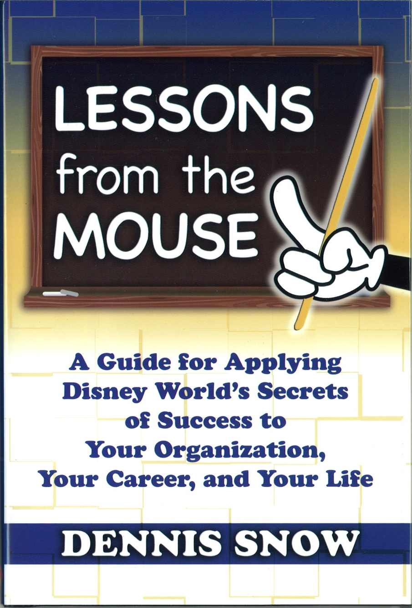
Leadership Institute June 13, 2017 Stonewall Resort

Slide 2
Lesson #1 Never Let Backstage Come Onstage
Customers don’t want to see Cinderella smoking a cigarette behind the Castle.
The enchantment is gone if the customers see the nuts and bolts of the operation.
Customers want Disney World to be Show Ready every day.
Every Disney employee is a member of the cast.
Customers don’t want to overhear Mickey talking about how incompetent Snow White is.

Slide 3
Discussion Questions
What makes up the physical backstage of your workplace?
What makes up the “attitudinal” backstage of your school?
What organization magic should not be compromised?
If we look at ourselves as “The Cast”, what do you think it means to be “Show Ready” in your classroom?
What can we do to make sure our school is “Show Ready” on a daily basis?

Slide 4
Lesson #2 What Time is the Three O’clock Parade? Is Not a Stupid Question.
Listen for the question behind the question.
Put yourself in the customer’s shoes.
Be empathetic.
Don’t use educational jargon to answer.
Answer each question with grace.
Answer each question with compassion.
Answer each question with interest.

Slide 5
Discussion Questions
Describe some of the common yet bizarre customer questions or behaviors that sometimes occur at your school.
What is the real question behind the question in some of those bizarre instances?
What are some examples of internal jargon that should be avoided?
How can you be sure that your customers who ask “bizarre” questions can be answered with dignity?
What are some things we can do to help us look through the eyes of the customer?

Slide 6
Lesson #3 Little Wows Add Up
Little Wows at Disney might include:
Giving a child new ice cream cone after he/she dropped it on the ground.
Handing out official citations for the biggest smile of the day.
A cast member picks up the “lost” look on a guest’s face and offers help.
Seeing a child’s name written on the back of his mouse ears, Snow White calls the child by name.

Slide 7
Discussion Questions
What are some examples of an occurrence that has caused one of your customers to literally exclaim, “Wow!”?
What are some examples of simple courtesies that put a smile on your customer’s face?
What behaviors demonstrate excellent responsiveness?
What opportunities are there to teach customers something they may not have known before?
What actions can you take to show your customers you really care?

Slide 8
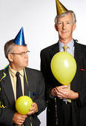
Lesson 4 Have Fun With the Job – No Matter How Miserable You Feel
Do you think it’s fun working at Disney when the temperature is 100 degrees and you’re trapped inside a wool costume?
Is it fun to be the guy who has to stand at the entrance of Space Mountain and tell guests the ride is closed today?
How many times can you listen to “It’s A Small World” without going completely bonkers?
Is it great fun working at Disney when you have to say “Watch Your Step” about 20,000 times per day?

Slide 9
Discussion Questions
What are some stressful or unpleasant aspects about your job? (Your Space Mountain is closed situations)
What are some ways of finding fun in those situations while being respectful to your customers?
Within reason, what does having fun with the job look like and sound like in your role at your school?
How does your workplace promote fun for employees?
What can be done to raise the fun factor in your office?

Slide 10
Lesson #5 Don’t Be a Customer Service Robot
Disney’s motto for employees: “Put a Smile in your Voice.”
Be animated not automated.

Slide 11
Discussion Questions
As a customer, what are some examples of robotic service you have received?
How did you feel about your experience when you received robotic service?
In your job, what routine tasks could potentially appear robotic to customers?
What can be done to personalize routine tasks?
How can you be sure that automated tasks at your school become more animated?

Slide 12
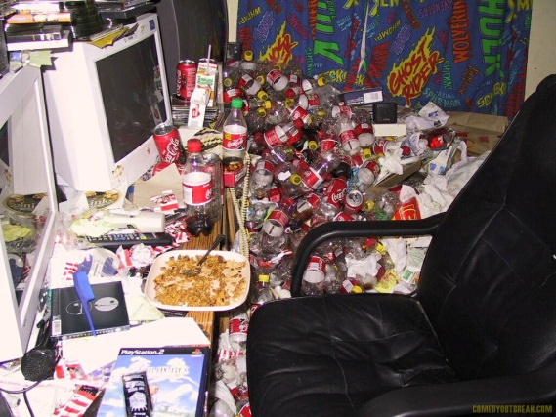
Lesson #6 Pay Attention to the Details – Everything Speaks
Disney names – Adventure Land, Fantasyland, etc., weren’t designed to just be catchy names. They were to meant to be authentic interpretations of a specific era or location.
Appropriate costuming for the ride.
Cast members picking up stray trash.
Trash cans located within easy reach of the customer.
Daily checklists.
Emergency plans – “The Dead Horse Procedure.”

Slide 13
Discussion Questions
How does the Everything Speaks philosophy apply to your job?
Take a mental walk through the physical environment of your school. What messages are being spoken there?
What needs to happen in order to ensure the details support our image?
What messages are being communicated to your students, staff, and parents through your physical environment?

Slide 14
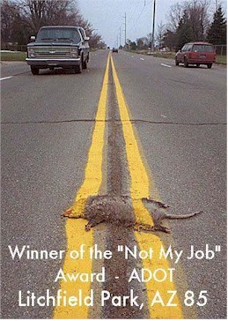
Lesson #7 Never Ever Say “That’s Not My Job” – Don’t Even Think It
Disney Philosophy: Just because it’s not in your area, doesn’t mean it’s not your job.
Disney creates a strong sense of ownership among the employees.
Customers first comment about Disney World is almost always related to how clean the place is.
Everyone, regardless of position, is held accountable for providing an excellent experience to customers.

Slide 15
Discussion Questions
What are some examples of the “It’s Not My Job” syndrome that you have experienced outside your school or office?
What are some examples of the “It’s Not My Job” syndrome that you have experienced inside your school?
How does the “It’s Not My Job” attitude impact our customers?
What are some examples of behaviors that would communicate a sense of ownership to your customers?
What can our school do to ensure that all employees demonstrate a sense of ownership?

Slide 16
Lesson #8 Everyone Has a Customer
At Disney, cast members are treated the way they are expected to treat the guests.
When Disney has to reprimand an employee, they make sure that they are able to leave the office with dignity.
Internal customers are every bit as important as external customers.
How you treat your colleagues will have a direct bearing on the effectiveness or the success of your organization – positively or negatively.

Slide 17
Discussion Questions
How effective are your Staff Members at treating each other as customers?
When an internal service breakdown occurs at your school, what is the impact on external customers?
Who are your internal customers?
What would excellent internal service look like in your school?
What are some actions our school should take in order to reinforce the importance of internal customer service.

Slide 18
Lesson #9 Figure Out What Ticks Off Your Customers – and Do Something About It
Sometimes the Disney Magic just doesn’t work.
A few Disney memories shouldn’t last a lifetime.

Slide 19
Discussion Questions
What are some frustrating processes you’ve endured as a customer?
How do you react when you experience processes that are designed for a company’s convenience and not yours?
What do customers find frustrating about doing business with you or your school?
Are you asking customers about their experience with your school? If so, what are you learning, and what are you doing about it? If not, when?

Slide 20
Lesson #10 Take Responsibility for Your Own Career
Ask and you shall receive.
Whining never helps.
Don’t fall into the trap of having the Victim’s Mentality.
Take charge of your career.
Let the boss know your goals.
Be a problem solver, not a problem creator.
Be passionate about your work.
Make your boss look good.
Always learn.

Slide 21
Discussion Questions
What opportunities have you asked for lately?
What have you done recently to gain new knowledge or skills in order to increase your value to your organization?
What can you do to take more responsibility for your career?
What can you do to ensure that your boss clearly understands your goals?
Who are your mentors?
Are you someone who makes things happen, watches things happen, or wonders what happened?

Slide 22
Although your customers won’t love you if you give bad service your competitors will. -Kate Zabriskie Choose to deliver amazing service to your customers. You'll stand out because they don't get it anywhere else. -Kevin Stirtz

Slide 23
Customers don’t expect you to be perfect. They do expect you to fix things when they go wrong. -Donald Porter Give the public everything you can give them, keep the place as clean as you can keep it, keep it friendly. -Walt Disney

Slide 24
If I pick up the phone, I accept the responsibility to ensure the caller is satisfied, no matter what the issue is. -Michael Ramundo

Slide 25
It is when we forget ourselves that we do things which will be remembered. -Anonymous

