Slide 1
Standard 5: Ethics
Dr. Mary Lu MacCorkle
April 17, 2018
West Virginia Cohort

Slide 2
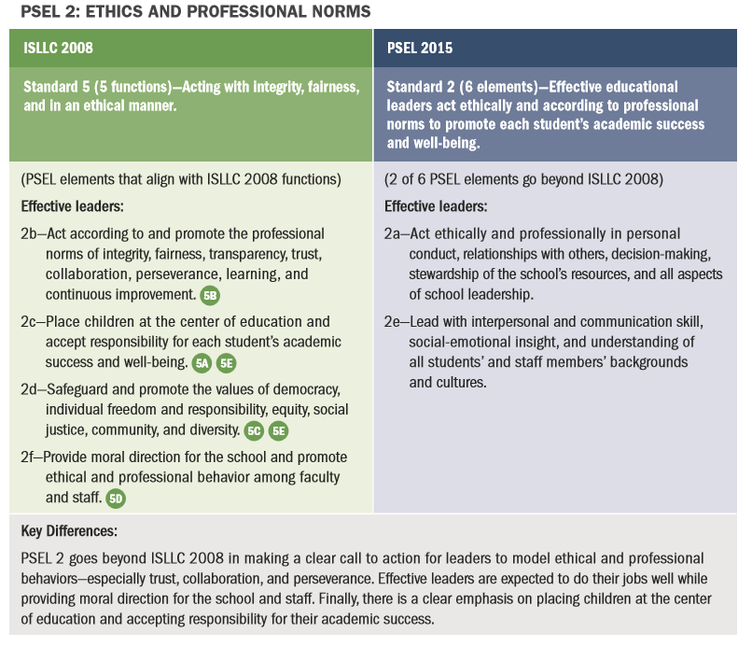
ISLLC Standard 5

Slide 3
5 functions of standard 5
Ensure a system of accountability for every student’s academic and social success
Model principles of self-awareness, reflective practice, transparency, and ethical behavior
Safeguard the values of democracy, equity, and diversity
Consider and evaluate the potential moral and legal consequences of decision-making
Promote social justice and ensure that individual student needs inform all aspects of schooling

Slide 4
Team Interpretations
Each group of three will be assigned one of the functions to discuss and interpret for the group. Explain and provide an example.

Slide 5
What are ethics?
What are the differences between ethics and morals?
Talk with a partner

Slide 6
 | Ethics | Morals
What are they? | The rules of conduct recognized in respect to a particular class of human actions or a particular group or culture. | Principles or habits with respect to right or wrong conduct. While morals also prescribe dos and don'ts, morality is ultimately a personal compass of right and wrong.
Where do they come from? | Social system - External | Individual - Internal
Why we do it? | Because society says it is the right thing to do. | Because we believe in something being right or wrong.
Flexibility | Ethics are dependent on others for definition. They tend to be consistent within a certain context, but can vary between contexts. | Usually consistent, although can change if an individual’s beliefs change.

Slide 7
Definition of Integrity
1 : firm adherence to a code of especially moral or artistic values : incorruptibility
2 : an unimpaired condition : soundness
3 : the quality or state of being complete or undivided : completeness

Slide 8
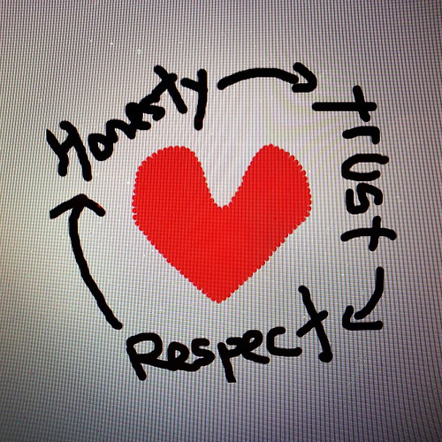
Responsibility
What is a principal’s responsibility in the realm of ethics?

Slide 9
Read
“What Principals Need to Know About Ethics”
by Rosa L. Weaver

Slide 10
Courageous Conversations
Jelly Bean Exercise
Purpose:
To help you (students) learn something about yourself and your personality.

Slide 11
Courageous Conversations
Pick your favorite jelly bean.
Don’t eat it, just grab it out of the bowl.
Wait for instruction….

Slide 12
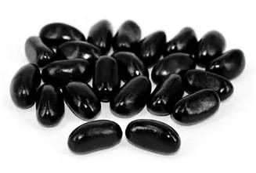
Courageous Conversations
White or Black
This individual is highly structured and organized
Surroundings are neat
If given an assignment, wants to know how many pages, exact requirements.
Always wants to know the rules
Memorized things well
Can’t stand sloppy, unorganized people
Deliberates before making decisions
sweetaddiction.com

Slide 13
Courageous Conversations
Yellow
Orange
Not usually outspoken
Always in a state of transition, whether they are 8 or 80
Usually smart and innovative, often artistic
Sometimes confused in making decisions, not sure where they’re supposed to be
Hard workers
Exciting to be with, will try anything as long as it’s safe
Spiritual aspects usually important to them
They look at things with perspective and respect others’ opinions
Cheerful and good-natured
Have the ability to get along well with almost anyone
They are friendly and have a ready smile
Usually have a quick wit
Fluent, often eloquent and profound in speech
Do not like to be left alone
Enjoy life and inspire others to reach their highest potential

Slide 14
Courageous Conversations
Violet/Blue
Flirty and passionate
Highly creative and highly excitable
Have new ideas and are visionaries
Short attention spans- can’t stay put for long at a time
Disorganized, often choosing to close doors rather than deal with the organization
Procrastinators who thrive on chaos, enjoy the challenges of different problems
Have a problem dealing with highly structured time
Questioning-when given an assignment, asks why it must be done a certain way, want to do it differently
Set high standards for themselves and those who work for them
Pinterst.com

Slide 15
Courageous Conversations
Red or Pink
Are courageous and their energy seems boundless
Smile much of the time
If they see someone not smiling, will ask what the problem is
Genuinely care about people and become involved in others’ problems
Highly influenced by others, share their sadness or grief
Make their decisions with feelings, act on impulses of the heart
Spend a great deal of time on the phone, usually listening to others
Sensitive, enthusiastic friends and lovers
amazon.com

Slide 16
Courageous Conversations
Green….
Please stand up.
amazon.com

Slide 17
Courageous Conversations
Green….
We always ask green to stand because they love recognition
These people are seen as leaders, usually in highly visible positions
They are respecters of authority and tradition
They are decisive, directed, and focused
They love black and white jelly bean people to organize their projects for them
amazon.com

Slide 18
Courageous Conversations
Jelly Bean Exercise Learning
Was your jelly bean valid for you?
This exercise is usually 80% correct.
No one is just one color, but there is a color that is dominant.

Slide 19
Courageous Conversations
Jelly Bean Exercise
We all share traits of the different colors but it is important to realize when we are dealing with others.
We should be ready to empathize with those who see differently.
We always need to know who we are dealing with.

Slide 20
Why does this matter when dealing with challenging situations with personnel?

Slide 21
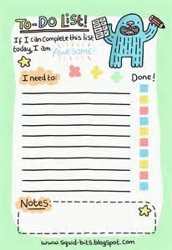
Courageous Conversations
Objectives:
1. Understand how we can go about having a courageous conversation
2. Reflecting on scenarios of positive and growth feedback
3. Plan a courageous conversation

Slide 22
ELI & ISLLC Connections
ISLLC
ELI
I exhibit empathy towards others when appropriate. 1.1, 1.3
I am aware of my emotions and how my emotions are perceived by others.1.4
I use data to determine and enact purposeful change. 1.2
I regularly assess the instructional practices of the faculty. 2.1, 2.2, 2.5
I have created a culture where problems are addressed with openness and transparency. 2.1,5.1, 5.2, 5.3
Culture & Climate
Management Skills
Instructional Leadership
Visionary Leadership
Emotional Intelligence

Slide 23
Talk with a partner
What do Courageous Conversations have to do with Ethics?

Slide 24
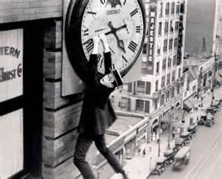
Hang On….
Courageous Conversations
“Bear in mind that while no single conversation is guaranteed to change the trajectory of a career, a school, a relationship, or a life, any single conversation can. Take it one conversation at a time. Be courageous!”
Excerpt From: Susan Scott. “Fierce Leadership.”
wallpaperjunctiondownload.blogspot.com

Slide 25
It takes Practice
Your ethical responsibility calls on you to have conversations which require tact, dispassion, clear purpose, trust, honesty, firm resolve and good relationships.
Practice!

Slide 26
What are you practicing?????
Courageous Conversations
shongjog.wordpress.com

Slide 27
Courageous Conversations
According to American Heritage Dictionary of the English Language
Prac · tice (prkts) means:
1. To do or perform habitually or customarily; make a habit of:
Practice withholding what one really thinks and feels
2. To do or perform repeatedly in order to acquire or polish a skill:
• practice blaming others for our poor results
3. To give lessons or repeated instructions; to drill:
• practice the team in overpromising and under-delivering
4. To work at, especially as a profession:
• practice law
5. To carry out in action; observe:
• practice a religion piously
shongjog.wordpress.com

Slide 28
Courageous Conversations
“I am practicing _______________________________.
I am practicing _______________________________.
I am practicing _______________________________.
I am practicing _______________________________.
I am practicing _______________________________.
I am practicing _______________________________.
I am practicing _______________________________.
I am practicing _______________________________.
I am practicing _______________________________.
Any insights?
Take a few minutes in a quiet place and journal what you are practicing.

Slide 29
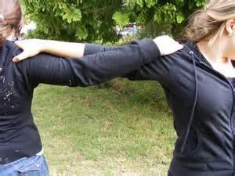
Courageous Conversations
Turn to your Shoulder Partner and talk about what you are practicing.
chinese-swords-guide.com

Slide 30
Courageous Conversations
A courageous conversation is one in which we come out from behind ourselves---and make it real.

Slide 31
Courageous Conversations
Move us from:
Silos and fiefdoms; competing for resources; not good at partnering
Sharing resources; collaborating; partnering across functions in service to the organization’s goals

Slide 32
Courageous Conversations
Move us from:
Information-starved, need-to-know culture.
Imposing one’s view of reality.
Open, transparent, respectful culture
Exposing one’s view of reality and inviting those with competing realities to share them

Slide 33
Courageous Conversations
Move us from:
Resistance to change; sleepwalking through the staff development; school as usual
Shared enthusiasm for agility and original thinking; a “new normal,” personally and organizationally

Slide 34
Courageous Conversations
• Stay current by exchanging feedback 365 days a year.
• Do it face to face whenever possible (and never via e-mail).
• Give it as soon as possible after something occurs.
• Praise is as important as criticism. Actually, it’s more important. So don’t just give feedback when it’s negative.
• Always own your comments. Feedback is invaluable. It’s anonymity that is the problem.

Slide 35
Courageous Conversations
My Own Conversations as a Leader
How do you know when it’s time for a Courageous/Crucial Conversation? What situations call for this type of conversation—Why?

Slide 36
Five step process
Prepare yourself:
Have the conversation in person
Have the facts in hand
Practice, Practice, Practice

Slide 37
Courageous Conversations
Step 2: Clarify and Purify-Make sure your purpose is clear.
Is your intention to:
interrogate reality (mine, as well as theirs)
provoke learning (mine, as well as theirs)
resolve a challenge; or
enrich the relationship
If so, you are good to go!

Slide 38
Courageous Conversations
Step 2: Clarify and Purify
Prepare opening statement:
limit to 60 seconds
write a rough draft, say it, practice it, prepare it
clear, clean and compelling
“I need to talk with you” is different from “I want to talk with you”

Slide 39
Courageous Conversations
Step 2: Clarify and Purify
Name the issue
I want to talk with you about the effects x is having on y.

Slide 40
Courageous Conversations
Step 2: Clarify and Purify
Select a specific example:
When you spoke with that student, your raised your voice, pointed your finger and leaned forward. I thought you looked aggressive.

Slide 41
Courageous Conversations
Step 2: Clarify and Purify
Describe your emotions around the issue.
Human beings behave first with their emotions.
“I was concerned for the student because you were in their body space and wondered how they felt toward you after this interaction and what their reaction might be.”

Slide 42
Courageous Conversations
Step 2: Clarify and Purify
Clarify what is at stake.
What is at stake for this student?
What is at stake for the adult?
What is at stake for their relationship?
“I am deeply concerned as there is a lot at stake here with this interaction. The student may react in an aggressive way and your actions could be called into question.”

Slide 43
Courageous Conversations
Step 2: Clarify and Purify
Identify your contribution to the problem
Rack your head to see if you caused this to happen and admit it.
“I may have overloaded you with too many responsibilities, if that is the case I apologize.”

Slide 44
Courageous Conversations
Step 2: Clarify and Purify
Invite your partner to respond.
“Please tell me what is going on from where you sit. I want to understand your perspective, learn your thoughts.”

Slide 45
Courageous Conversations
Step 2: Clarify and Purify
Indicate your wish to resolve the issue.
“I want to resolve this issue with how you are interacting with your student.”

Slide 46
Courageous Conversations
Errors ~ Avoid them….
How’s it going?
False comradery
Too many pillows
Writing the script too far in advance
Machine gun Nelly

Slide 47
Courageous Conversations
Step 3: Do it. Have the conversation
Listen
Resist the urge to jump in/interrupt
Don’t get defensive
Silence can do heavy lifting
If they are off base, examine with questions.
Given everything that has happened, what do you think should happen next?

Slide 48
Courageous Conversations
Step 3: Tactics that may be used by the participant
Denial
Defensiveness
Deflection

Slide 49
Courageous Conversations
Step 4: Debrief-follow up in writing if a plan has emerged.
This is essential.
“Thank you for hearing what I had to say and for sharing your perspective. Your success is important to me and I applaud your commitment to action. Before I leave I welcome any thoughts you have about this conversation and how I can get better at giving feedback. I want to do better moving forward.”

Slide 50
Courageous Conversations
Step 5: Do it again. Only better.
Tend to your garden.
theonlineflowergarden.com

Slide 51
Courageous Conversations
Praise with Courage!
1. Prepare Yourself
2. Prepare Others
3. Have the conversation
4. Debrief
5. Do it Again Only Better

Slide 52
Scenario 1
What is the core issue here?
Why do you need a Courageous Conversation?
What ethical standard requires you to address this issue?
What would be your goal?
How would you begin this conversation?

Slide 53
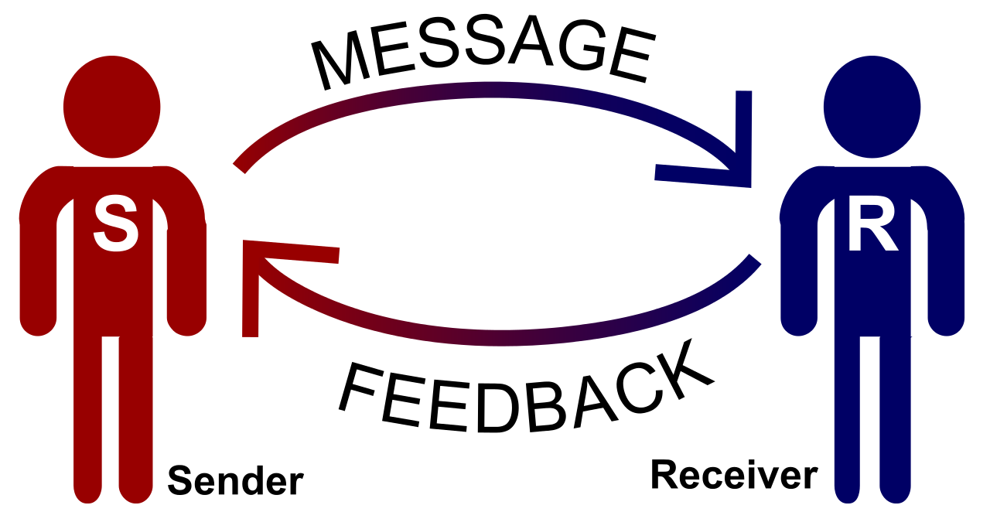
Group Scenarios
Each team will have a scenario from a PLC. Write an opening statement to get the conversation going.

Slide 54
Courageous Conversations
With whom else might you have to have conversations?

