Slide 1
Debbie Lane, Ed.D.
Building Leadership Capacity in Rural WV
Beckley, WV
January 6, 2015

Slide 2
Agenda
Morning Session
Afternoon Session
8:30-8:45 Jelly Bean Warm-Up
8:45 My Own Conversation
9:00 Courageous Conversations
10:00 ~Break~
10:15 Scenarios
11:30 ~Lunch~
12:15 Scenario work
1:00 Alignment to Our Work
2:00 Mapping my Own Conversation

Slide 3
Courageous Conversations
Jelly Bean Exercise
Purpose:
To help you (students) learn something about yourself and your personality.

Slide 4
Courageous Conversations
Pick your favorite jelly bean.
Don’t eat it, just grab it out of the bowl.
Wait for instruction….

Slide 5
Courageous Conversations
Please sit according to your favorite bean:
Table 1- Black/ white
Table 2 - Red/Pink
Table 3 - Green/Yellow
Table 4 - Violet/Orange

Slide 6
Courageous Conversations
White or Black
This individual is highly structured and organized
Surroundings are neat
If given an assignment, wants to know how many pages, exact requirements.
Always wants to know the rules
Memorized things well
Can’t stand sloppy, unorganized people
Deliberates before making decisions
sweetaddiction.com

Slide 7
Courageous Conversations
Yellow
Orange
Not usually outspoken
Always in a state of transition, whether they are 8 or 80
Usually smart and innovative, often artistic
Sometimes confused in making decisions, not sure where they’re supposed to be
Hard workers
Exciting to be with, will try anything as long as it’s safe
Spiritual aspects usually important to them
They look at things with perspective and respect others’ opinions
Cheerful and good-natured
Have the ability to get along well with almost anyone
They are friendly and have a ready smile
Usually have a quick wit
Fluent, often eloquent and profound in speech
Do not like to be left alone
Enjoy life and inspire others to reach their highest potential

Slide 8
Courageous Conversations
Violet
Flirty and passionate
Highly creative and highly excitable
Have new ideas and are visionaries
Short attention spans- can’t stay put for long at a time
Disorganized, often choosing to close doors rather than deal with the organization
Procrastinators who thrive on chaos, enjoy the challenges of different problems
Have a problem dealing with highly structured time
Questioning-when given an assignment, asks why it must be done a certain way, want to do it differently
Set high standards for themselves and those who work for them
Pinterst.com

Slide 9
Courageous Conversations
Red or Pink
Are courageous and their energy seems boundless
Smile much of the time
If they see someone not smiling, will ask what the problem is
Genuinely care about people and become involved in others’ problems
Highly influenced by others, share their sadness or grief
Make their decisions with feelings, act on impulses of the heart
Spend a great deal of time on the phone, usually listening to others
Sensitive, enthusiastic friends and lovers
amazon.com

Slide 10
Courageous Conversations
Green….
Please stand up.
amazon.com

Slide 11
Courageous Conversations
Green….
We always ask green to stand because they love recognition
These people are seen as leaders, usually in highly visible positions
They are respecters of authority and tradition
They are decisive, directed, and focused
They love black and white jelly bean people to organize their projects for them
amazon.com

Slide 12
Courageous Conversations
Jelly Bean Exercise Learning
Was your jelly bean valid for you?
This exercise is usually 80% correct.
No one is just one color, but there is a color that is dominant.

Slide 13
Courageous Conversations
Jelly Bean Exercise
We all share traits of the different colors but it is important to realize when we are dealing with others.
We should be ready to empathize with those who see differently.

Slide 14
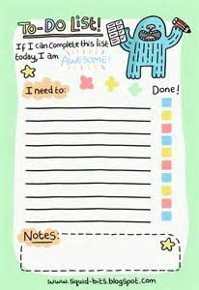
Courageous Conversations
Objectives:
Understand how we can go about having a courageous conversation
Reflecting on scenarios of positive and growth feedback
Plan a courageous conversation
Learn how this will fit into my action plan

Slide 15
ELI & ISLC Connections
ISLLC
ELI
Culture & Climate
Management Skills
Instructional Leadership
Visionary Leadership
Emotional Intelligence
I exhibit empathy towards others when appropriate. 1.1, 1.3
I am aware of my emotions and how my emotions are perceived by others.1.4
I use data to determine and enact purposeful change. 1.2
I regularly assess the instructional practices of the faculty. 2.1, 2.2, 2.5
I have created a culture where problems are addressed with openness and transparency. 2.1,5.1, 5.2, 5.3

Slide 16
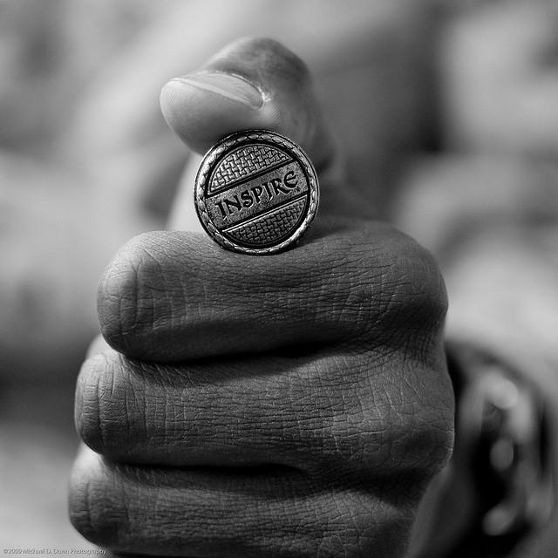
Courageous Conversations
“I would not give a fig for simplicity on this side of complexity, but I would give my life for simplicity on the other side of complexity.”
—OLIVER WENDELL HOLMES

Slide 17
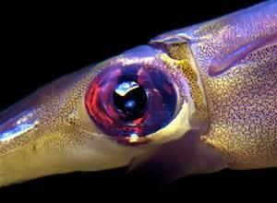
Squid Eyes
Courageous Conversations
Earthtime.org

Slide 18
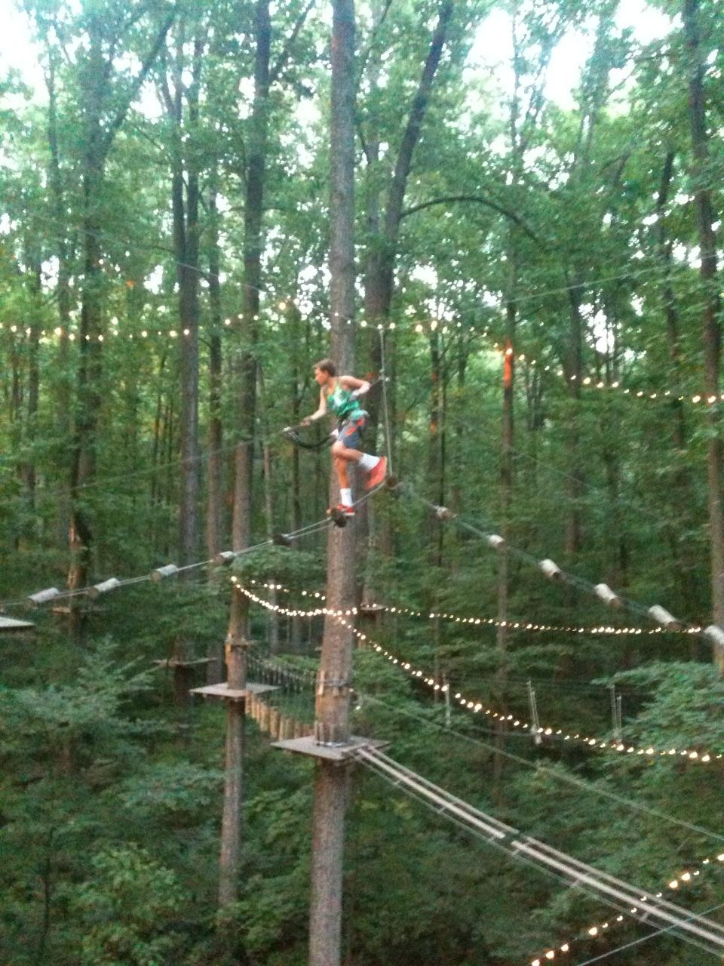
Courageous Conversations
Practice, Practice, Practice
“You are always practicing something. The question is: What are you practicing?”
—MARTIAL ARTS SENSEI

Slide 19
Hang On….
Courageous Conversations
1. To hold off all sorts of pull in your life, stay alert/awake and hold on to body parts!
2. Names and Ideas will come to you. Often in the night. Write these down. Think of colleagues you should promote as well as colleagues you need to confront.
Excerpt From: Susan Scott. “Fierce Leadership.”
wallpaperjunctiondownload.blogspot.com

Slide 20
Hang On….
Courageous Conversations
3. “You will not single-handedly cause or prevent success. Surround yourself with people who model accountability, ferocious integrity, personal authenticity, the capacity to connect with others at a deep level, sheer courage, and a commitment to champion the common good over narrow self-interest.”
Excerpt From: Susan Scott. “Fierce Leadership.”
wallpaperjunctiondownload.blogspot.com

Slide 21
Hang On….
Courageous Conversations
4. YOUR central function is to engineer intelligent conversations that provide a basis for alignment, collaboration, and partnership as well as healthier outcomes.
Excerpt From: Susan Scott. “Fierce Leadership.”
wallpaperjunctiondownload.blogspot.com

Slide 22
Hang On….
Courageous Conversations
5. People may not wish you well. You are not invincible. Be kind. Remind yourself that everyone is carrying a heavy load!
Excerpt From: Susan Scott. “Fierce Leadership.”
wallpaperjunctiondownload.blogspot.com

Slide 23
Hang On….
Courageous Conversations
6. Don’t kiss up or your soul will not accompany you. Just keep describing reality from your perspective without laying blame and you’ll be fine.
Excerpt From: Susan Scott. “Fierce Leadership.”
wallpaperjunctiondownload.blogspot.com

Slide 24
Hang On….
Courageous Conversations
7. Don’t ever lie to cover yourself. It will come back to bite you. Be truthful.
Excerpt From: Susan Scott. “Fierce Leadership.”
wallpaperjunctiondownload.blogspot.com

Slide 25
Hang On….
Courageous Conversations
8. Show up as yourself. Be authentic.
Excerpt From: Susan Scott. “Fierce Leadership.”
wallpaperjunctiondownload.blogspot.com

Slide 26
Hang On….
Courageous Conversations
9. “Bear in mind that while no single conversation is guaranteed to change the trajectory of a career, a school, a relationship, or a life, any single conversation can. Take it one conversation at a time. Be courageous!”
Excerpt From: Susan Scott. “Fierce Leadership.”
wallpaperjunctiondownload.blogspot.com

Slide 27
Imagine a kaleidoscope
Courageous Conversations
shongjog.wordpress.com

Slide 28
What are you practicing?????
Courageous Conversations
shongjog.wordpress.com

Slide 29
Courageous Conversations
According to American Heritage Dictionary of the English Language
Prac · tice (prkts) means:
1. To do or perform habitually or customarily; make a habit of:
• practice courtesy in social situations; make a practice of being punctual
• practice withholding what one really thinks and feels
2. To do or perform repeatedly in order to acquire or polish a skill:
• practice a dance step
• practice blaming others for our poor results
shongjog.wordpress.com

Slide 30
Courageous Conversations
According to American Heritage Dictionary of the English Language
Prac · tice (prkts) means:
3. To give lessons or repeated instructions; to drill:
• practice the students in handwriting
• practice the team in overpromising and under-delivering
4. To work at, especially as a profession:
• practice law
5. To carry out in action; observe:
• practice a religion piously
shongjog.wordpress.com

Slide 31
Courageous Conversations
Take 10 minutes to find a quiet place and journal what you are practicing.
“I am practicing _______________________________.
I am practicing _______________________________.
I am practicing _______________________________.
I am practicing _______________________________.
I am practicing _______________________________.
I am practicing _______________________________.
I am practicing _______________________________.
I am practicing _______________________________.
I am practicing _______________________________.
Any insights?

Slide 32
Courageous Conversations
Turn to your Shoulder Partner and talk about what you are practicing. You each will have 5 minutes.
chinese-swords-guide.com

Slide 33
Courageous Conversations
A courageous conversation is one in which we come out from behind ourself. And make it real.

Slide 34
Courageous Conversations
“Real is a change agent’s best friend. While no one has to change, when the conversation is real, the change often occurs before the conversation has ended. ”
Excerpt From: Susan Scott. “Fierce Leadership.” iBooks. https://itun.es/us/U_Sez.l

Slide 35
Courageous Conversations
When you think of a courageous conversation, think authenticity, integrity, collaboration.
Think execution muscle, innovation, emotional capital.
Think collaboration—with your colleagues and clients (parents, teachers, students, community members).
howtoee.com

Slide 36
Courageous Conversations
Daniel Pink, author of A Whole New Mind,
“we are moving from the ‘industrial age’ into the ‘conceptual age.’”
What this means is that today we are making different choices about how we live our lives, who we spend our time with, and how we spend our money.

Slide 37
Courageous Conversations
Ye Ole Methods of Leadership
Feedback-free, development-free zone; little, if any, personal growth
Feedback-rich, development-rich zone; ongoing personal growth

Slide 38
Courageous Conversations
Ye Ole Methods of Leadership
Directing and telling Really asking, really listening

Slide 39
Courageous Conversations
Ye Ole Methods of Leadership
High task/low relationship and the culture of compliance that goes with it
High task/high relationship and the culture of passionate engagement that goes with it

Slide 40
Courageous Conversations
Ye Ole Methods of Leadership
Silos and fiefdoms; competing for resources; not good at partnering
Sharing resources; collaborating; partnering across functions in service to the organization’s goals

Slide 41
Courageous Conversations
Ye Ole Methods of Leadership
Information-starved, need-to-know culture.
Open, transparent, respectful culture
Impose one’s view of reality.
Expose one’s view of reality and invite those with competing realities to share them”

Slide 42
Courageous Conversations
Ye Ole Methods of Leadership
Resistance to change; sleepwalking through the staff development; school as usual
Shared enthusiasm for agility and original thinking; a “new normal,” personally and organizationally.

Slide 43
Courageous Conversations
“Like all toxins, anonymity should be kept as close to zero as possible.”
—Kevin Kelly

Slide 44
Courageous Conversations
“I’m not afraid of death. I just don’t want to be there when it happens.”
-Woody Allen

Slide 45
Courageous Conversations
• Stay current by exchanging feedback 365 days a year.
• Do it face to face whenever possible (and never via e-mail).
• Give it as soon as possible after something occurs.
• Praise is as important as criticism. Actually, it’s more important. So don’t just give feedback when it’s negative.
• Always own your comments. Feedback is invaluable. It’s anonymity that is the problem.

Slide 46
Courageous Conversations
Scenario
Lunch

Slide 47
Courageous Conversations
My Own Conversations as a Leader

Slide 48
Courageous Conversations
Step One: Prepare Yourself
Have the conversation in person

Slide 49
Courageous Conversations
Step 2: Clarify and Purify
Is your intention to:
interrogate reality (mine, as well as theirs)
provoke learning (mine, as well as theirs)
resolve a touch challenge; or
enrich the relationship
If so, you are good to go!

Slide 50
Courageous Conversations
Step 2: Clarify and Purify
Prepare open statement:
limit to 60 seconds
write a rough draft, say it, practice it, prepare it
clear, clean and compelling
“I need to talk with you” is different from “I want to talk with you”

Slide 51
Courageous Conversations
Step 2: Clarify and Purify
Name the issue
I want to talk with you about the effects x is having on y.

Slide 52
Courageous Conversations
Step 2: Clarify and Purify
Select a specific example:
When you spoke with that student, your raised your voice, pointed your finger and leaned forward. I thought you looked aggressive.

Slide 53
Courageous Conversations
Step 2: Clarify and Purify
Describe your emotions around the issue.
Human beings behave first with their emotions.
“I was concerned for the student how you were in their body space and wondered how they felt towards you after this interaction.”

Slide 54
Courageous Conversations
Step 2: Clarify and Purify
Clarify what is at stake.
What is at stake for this student?
What is at stake for their relationship?
“I am deeply concerned as there is a lot at stake here with this interaction.”

Slide 55
Courageous Conversations
Step 2: Clarify and Purify
Identify your contribution to the problem
Rack your head to see if you caused this to happen and admit it.
“I may have overloaded you with too many responsibilities, if that is the case I apologize.”

Slide 56
Courageous Conversations
Step 2: Clarify and Purify
Invite your partner to respond.
“Please tell me what is going on from where you sit. I want to understand your perspective, learn your thoughts.”

Slide 57
Courageous Conversations
Step 2: Clarify and Purify
Indicate your wish to resolve the issue.
“I want to resolve this issue with how you are interacting with your student.”

Slide 58
Courageous Conversations
Errors ~ Avoid them….
How’s it going?
Crap filled jolly
Too many pillows
Writing the script too far in advance
Machine gun Nelly

Slide 59
Courageous Conversations
Scenario 2

Slide 60
Courageous Conversations
Step 3: Do it. Have the conversation
Listen
Resist to jump in
Don’t get defensive
Silence can do heavy lifting
If they are off base, examine with questions.
Given everything that has happened, what do you think should happen next?

Slide 61
Courageous Conversations
Step 3: Tactics used
Denial
Defensiveness
Deflection

Slide 62
Courageous Conversations
Step 4: Debrief
This is essential.
“Thank you for hearing what I had to say and for sharing your perspective. Your success is important to me and I applaud your commitment to action. Before I leave I welcome any thoughts you have about this conversation and how I can get better at giving feedback. I want to do better moving forward.”

Slide 63
Courageous Conversations
Step 5: Do it again. Only better.
Tend to your garden.
theonlineflowergarden.com

Slide 64
Courageous Conversations
Praise with Courage!
1. Prepare Yourself
2. Prepare Others
3. Have the conversation
4. Debrief
5. Do it Again Only Better

Slide 65
Courageous Conversations
Listen.
In every office
you hear the threads
of love and joy and fear and guilt,
the cries for celebration and reassurance,
and somehow you know that connecting those threads
is what you are supposed to do
and business takes care of itself.
-by David Whyte
irishsymbolcourage.pininterst

Slide 66
Courageous Conversations
Move to your District Tables
Take time to discuss one courageous conversation you plan to have back in your school next week.
How is this part of your action plan?
Dates we meet again: 2/10 (make-up 2/11)

Slide 67
Where are you with your plan?

Slide 68
Agenda
Morning Session
Afternoon Session
8:30-8:45 Jelly Bean Warm-Up
8:45 My Own Conversation
9:00 Courageous Conversations
10:00 ~Break~
10:15 Scenarios
11:30 ~Lunch~
12:15 Scenario work
1:00 Alignment to Our Work
2:00 Mapping my Own Conversation

Slide 69
Courageous Conversations
Jellly Bean Exercise
Purpose:
To help you (students) learn something about yourself and your personality.

Slide 70
Courageous Conversations
Pick your favorite jelly bean.
Don’t eat it, just grab it out of the bowl.
Wait for instruction….

Slide 71
Courageous Conversations
Please sit according to your favorite bean:
Table 1- Black/ white
Table 2 - Red/Pink
Table 3 - Green/Yellow
Table 4 - Violet/Orange

Slide 72
Courageous Conversations
White or Black
This individual is highly structured and organized
Surroundings are neat
If given an assignment, wants to know how many pages, exact requirements.
Always wants to know the rules
Memorized things well
Can’t stand sloppy, unorganized people
Deliberates before making decisions
sweetaddiction.com

Slide 73
Courageous Conversations
Yellow
Orange
Not usually outspoken
Always in a state of transition, whether they are 8 or 80
Usually smart and innovative, often artistic
Sometimes confused in making decisions, not sure where they’re supposed to be
Hard workers
Exciting to be with, will try anything as long as it’s safe
Spiritual aspects usually important to them
They look at things with perspective and respect others’ opinions
Cheerful and good-natured
Have the ability to get along well with almost anyone
They are friendly and have a ready smile
Usually have a quick wit
Fluent, often eloquent and profound in speech
Do not like to be left alone
Enjoy life and inspire others to reach their highest potential

Slide 74
Courageous Conversations
Violet
Flirty and passionate
Highly creative and highly excitable
Have new ideas and are visionaries
Short attention spans- can’t stay put for long at a time
Disorganized, often choosing to close doors rather than deal with the organization
Procrastinators who thrive on chaos, enjoy the challenges of different problems
Have a problem dealing with highly structured time
Questioning-when given an assignment, asks why it must be done a certain way, want to do it differently
Set high standards for themselves and those who work for them
Pinterst.com

Slide 75
Courageous Conversations
Red or Pink
Are courageous and their energy seems boundless
Smile much of the time
If they see someone not smiling, will ask what the problem is
Genuinely care about people and become involved in others’ problems
Highly influenced by others, share their sadness or grief
Make their decisions with feelings, act on impulses of the heart
Spend a great deal of time on the phone, usually listening to others
Sensitive, enthusiastic friends and lovers
amazon.com

Slide 76
Courageous Conversations
Green….
Please stand up.
amazon.com

Slide 77
Courageous Conversations
Green….
We always ask green to stand because they love recognition
These people are seen as leaders, usually in highly visible positions
They are respecters of authority and tradition
They are decisive, directed, and focused
They love black and white jelly bean people to organize their projects for them
amazon.com

Slide 78
Courageous Conversations
Jellly Bean Exercise Learning
Was your jelly bean valid for you?
This exercise is usually 80% correct.
No one is just one color, but there is a color that is dominant.

Slide 79
Courageous Conversations
Jellly Bean Exercise
We all share traits of the different colors but it is important to realize when we are dealing with others.
We should be ready to empathize with those who see differently.

Slide 80
Courageous Conversations
Objectives:
Understand how we can go about having a courageous conversation
Reflecting on scenarios of positive and growth feedback
Plan a courageous conversation
Learn how this will fit into my action plan

Slide 81
ELI & ISLC Connections
ELI
ISLLC
Culture & Climate
Management Skills
Instructional Leadership
Visionary Leadership
Emotional Intelligence
I exhibit empathy towards others when appropriate. 1.1, 1.3
I am aware of my emotions and how my emotions are perceived by others.1.4
I use data to determine and enact purposeful change. 1.2
I regularly assess the instructional practices of the faculty. 2.1, 2.2, 2.5
I have created a culture where problems are addressed with openness and transparency. 2.1,5.1, 5.2, 5.3

Slide 82
Courageous Conversations
“I would not give a fig for simplicity on this side of complexity, but I would give my life for simplicity on the other side of complexity.”
—OLIVER WENDELL HOLMES

Slide 83
Squid Eyes
Courageous Conversations
Earthtime.org

Slide 84
Courageous Conversations
Practice, Practice, Practice
“You are always practicing something. The question is: What are you practicing?”
—MARTIAL ARTS SENSEI

Slide 85
Hang On….
Courageous Conversations
1. To hold off all sorts of pull in your life, stay alert/awake and hold on to body parts!
2. Names and Ideas will come to you. Often in the night. Write these down. Think of colleagues you should promote as well as colleagues you need to confront.
Excerpt From: Susan Scott. “Fierce Leadership.”
wallpaperjunctiondownload.blogspot.com

Slide 86
Hang On….
Courageous Conversations
3. “You will not single-handedly cause or prevent success. Surround yourself with people who model accountability, ferocious integrity, personal authenticity, the capacity to connect with others at a deep level, sheer courage, and a commitment to champion the common good over narrow self-interest.”
Excerpt From: Susan Scott. “Fierce Leadership.”
wallpaperjunctiondownload.blogspot.com

Slide 87
Hang On….
Courageous Conversations
4. YOUR central function is to engineer intelligent conversations that provide a basis for alignment, collaboration, and partnership as well as healthier outcomes.
Excerpt From: Susan Scott. “Fierce Leadership.”
wallpaperjunctiondownload.blogspot.com

Slide 88
Hang On….
Courageous Conversations
5. People may not wish you well. You are not invincible. Be kind. Remind yourself that everyone is carrying a heavy load!
Excerpt From: Susan Scott. “Fierce Leadership.”
wallpaperjunctiondownload.blogspot.com

Slide 89
Hang On….
Courageous Conversations
6. Don’t kiss up or your soul will not accompany you. Just keep describing reality from your perspective without laying blame and you’ll be fine.
Excerpt From: Susan Scott. “Fierce Leadership.”
wallpaperjunctiondownload.blogspot.com

Slide 90
Hang On….
Courageous Conversations
7. Don’t ever lie to cover yourself. It will come back to bite you. Be truthful.
Excerpt From: Susan Scott. “Fierce Leadership.”
wallpaperjunctiondownload.blogspot.com

Slide 91
Hang On….
Courageous Conversations
8. Show up as yourself. Be authentic.
Excerpt From: Susan Scott. “Fierce Leadership.”
wallpaperjunctiondownload.blogspot.com

Slide 92
Hang On….
Courageous Conversations
9. “Bear in mind that while no single conversation is guaranteed to change the trajectory of a career, a school, a relationship, or a life, any single conversation can. Take it one conversation at a time. Be courageous!”
Excerpt From: Susan Scott. “Fierce Leadership.”
wallpaperjunctiondownload.blogspot.com

Slide 93
Imagine a kaleidoscope
Courageous Conversations
shongjog.wordpress.com

Slide 94
What are you practicing?????
Courageous Conversations
shongjog.wordpress.com

Slide 95
Courageous Conversations
According to American Heritage Dictionary of the English Language
Prac · tice (prkts) means:
1. To do or perform habitually or customarily; make a habit of:
• practice courtesy in social situations; make a practice of being punctual
• practice withholding what one really thinks and feels
2. To do or perform repeatedly in order to acquire or polish a skill:
• practice a dance step
• practice blaming others for our poor results
shongjog.wordpress.com

Slide 96
Courageous Conversations
According to American Heritage Dictionary of the English Language
Prac · tice (prkts) means:
3. To give lessons or repeated instructions; to drill:
• practice the students in handwriting
• practice the team in overpromising and under-delivering
4. To work at, especially as a profession:
• practice law
5. To carry out in action; observe:
• practice a religion piously
shongjog.wordpress.com

Slide 97
Courageous Conversations
Take 10 minutes to find a quiet place and journal what you are practicing.
“I am practicing _______________________________.
I am practicing _______________________________.
I am practicing _______________________________.
I am practicing _______________________________.
I am practicing _______________________________.
I am practicing _______________________________.
I am practicing _______________________________.
I am practicing _______________________________.
I am practicing _______________________________.
Any insights?

Slide 98
Courageous Conversations
Turn to your Shoulder Partner and talk about what you are practicing. You each will have 5 minutes.
chinese-swords-guide.com

Slide 99
Courageous Conversations
A courageous conversation is one in which we come out from behind ourself. And make it real.

Slide 100
Courageous Conversations
“Real is a change agent’s best friend. While no one has to change, when the conversation is real, the change often occurs before the conversation has ended. ”
Excerpt From: Susan Scott. “Fierce Leadership.” iBooks. https://itun.es/us/U_Sez.l

Slide 101
Courageous Conversations
When you think of a courageous conversation, think authenticity, integrity, collaboration.
Think execution muscle, innovation, emotional capital.
Think collaboration—with your colleagues and clients (parents, teachers, students, community members).
howtoee.com

Slide 102
Courageous Conversations
Daniel Pink, author of A Whole New Mind,
“we are moving from the ‘industrial age’ into the ‘conceptual age.’”
What this means is that today we are making different choices about how we live our lives, who we spend our time with, and how we spend our money.

Slide 103
Courageous Conversations
Ye Ole Methods of Leadership
Feedback-free, development-free zone; little, if any, personal growth
Feedback-rich, development-rich zone; ongoing personal growth

Slide 104
Courageous Conversations
Ye Ole Methods of Leadership
Directing and telling Really asking, really listening

Slide 105
Courageous Conversations
Ye Ole Methods of Leadership
High task/low relationship and the culture of compliance that goes with it
High task/high relationship and the culture of passionate engagement that goes with it

Slide 106
Courageous Conversations
Ye Ole Methods of Leadership
Silos and fiefdoms; competing for resources; not good at partnering
Sharing resources; collaborating; partnering across functions in service to the organization’s goals

Slide 107
Courageous Conversations
Ye Ole Methods of Leadership
Information-starved, need-to-know culture.
Open, transparent, respectful culture
Impose one’s view of reality.
Expose one’s view of reality and invite those with competing realities to share them”

Slide 108
Courageous Conversations
Ye Ole Methods of Leadership
Resistance to change; sleepwalking through the staff development; school as usual
Shared enthusiasm for agility and original thinking; a “new normal,” personally and organizationally.

Slide 109
Courageous Conversations
“Like all toxins, anonymity should be kept as close to zero as possible.”
—Kevin Kelly

Slide 110
Courageous Conversations
“I’m not afraid of death. I just don’t want to be there when it happens.”
-Woody Allen

Slide 111
Courageous Conversations
• Stay current by exchanging feedback 365 days a year.
• Do it face to face whenever possible (and never via e-mail).
• Give it as soon as possible after something occurs.
• Praise is as important as criticism. Actually, it’s more important. So don’t just give feedback when it’s negative.
• Always own your comments. Feedback is invaluable. It’s anonymity that is the problem.

Slide 112
Courageous Conversations
Scenario
Lunch

Slide 113
Courageous Conversations
My Own Conversations as a Leader

Slide 114
Courageous Conversations
Step One: Prepare Yourself
Have the conversation in person

Slide 115
Courageous Conversations
Step 2: Clarify and Purify
Is your intention to:
interrogate reality (mine, as well as theirs)
provoke learning (mine, as well as theirs)
resolve a touch challenge; or
enrich the relationship
If so, you are good to go!

Slide 116
Courageous Conversations
Step 2: Clarify and Purify
Prepare open statement:
limit to 60 seconds
write a rough draft, say it, practice it, prepare it
clear, clean and compelling
“I need to talk with you” is different from “I want to talk with you”

Slide 117
Courageous Conversations
Step 2: Clarify and Purify
Name the issue
I want to talk with you about the effects x is having on y.

Slide 118
Courageous Conversations
Step 2: Clarify and Purify
Select a specific example:
When you spoke with that student, your raised your voice, pointed your finger and leaned forward. I thought you looked aggressive.

Slide 119
Courageous Conversations
Step 2: Clarify and Purify
Describe your emotions around the issue.
Human beings behave first with their emotions.
“I was concerned for the student how you were in their body space and wondered how they felt towards you after this interaction.”

Slide 120
Courageous Conversations
Step 2: Clarify and Purify
Clarify what is at stake.
What is at stake for this student?
What is at stake for their relationship?
“I am deeply concerned as there is a lot at stake here with this interaction.”

Slide 121
Courageous Conversations
Step 2: Clarify and Purify
Identify your contribution to the problem
Rack your head to see if you caused this to happen and admit it.
“I may have overloaded you with too many responsiblities, if that is the case I apologize.”

Slide 122
Courageous Conversations
Step 2: Clarify and Purify
Invite your partner to respond.
“Please tell me what is going on from where you sit. I want to understand your perspective, learn your thoughts.”

Slide 123
Courageous Conversations
Step 2: Clarify and Purify
Indicate your wish to resolve the issue.
“I want to resolve this issue with how you are interacting with your student.”

Slide 124
Courageous Conversations
Errors ~ Avoid them….
How’s it going?
Crap filled jolly
Too many pillows
Writing the script too far in advance
Machine gun Nelly

Slide 125
Courageous Conversations
Scenario 2

Slide 126
Courageous Conversations
Step 3: Do it. Have the conversation
Listen
Resist to jump in
Don’t get defensive
Silence can do heavy lifting
If they are off base, examine with questions.
Given everything that has happened, what do you think should happen next?

Slide 127
Courageous Conversations
Step 3: Tactics used
Denial
Defensiveness
Deflection

Slide 128
Courageous Conversations
Step 4: Debrief
This is essential.
“Thank you for hearing what I had to say and for sharing your perspective. Your success is important to me and I applaud your commitment to action. Before I leave I welcome any thoughts you have about this conversation and how I can get better at giving feedback. I want to do better moving forward.”

Slide 129
Courageous Conversations
Step 5: Do it again. Only better.
Tend to your garden.
theonlineflowergarden.com

Slide 130
Courageous Conversations
Praise with Courage!
1. Prepare Yourself
2. Prepare Others
3. Have the conversation
4. Debrief
5. Do it Again Only Better

Slide 131
Courageous Conversations
Listen.
In every office
you hear the threads
of love and joy and fear and guilt,
the cries for celebration and reassurance,
and somehow you know that connecting those threads
is what you are supposed to do
and business takes care of itself.
-by David Whyte
irishsymbolcourage.pininterst

Slide 132
Courageous Conversations
Move to your District Tables
Take time to discuss one courageous conversation you plan to have back in your school next week.
How is this part of your action plan?
Dates we meet again: 2/10 (make-up 2/11)

Slide 133
Where are you with your plan?

