Slide 1
Visionary and Instructional Leadership
Dr. Laurie Barron
Superintendent
Evergreen School District
Kalispell, Montana
2013 MetLife/NASSP National Middle Level Principal of the Year
lauriebarron18@gmail.com
@LaurieBarron (Twitter)

Slide 2

Building a School Culture for Improvement

Slide 3
The “WHAT” of the
Breaking Ranks® Framework
Cornerstones
Core Areas
Recommendations
Leadership
Assessment
Curriculum,
Instruction &
Assessment
Collaborative Leadership
Equity
9 Recommendations
12 Recommendations
Relationships
Improved
Student
Performance
Culture
Instruction
Personalizing your School Environment
Curriculum
8 Recommendations
Organization
Professional Development

Slide 4
Calling All Superheroes

Slide 5

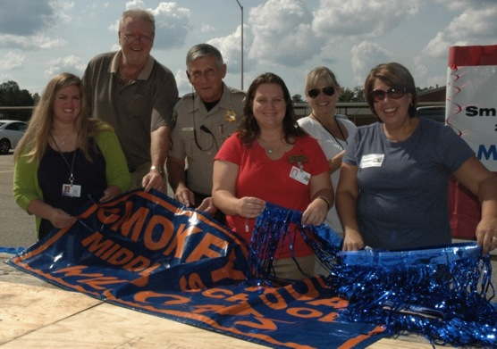

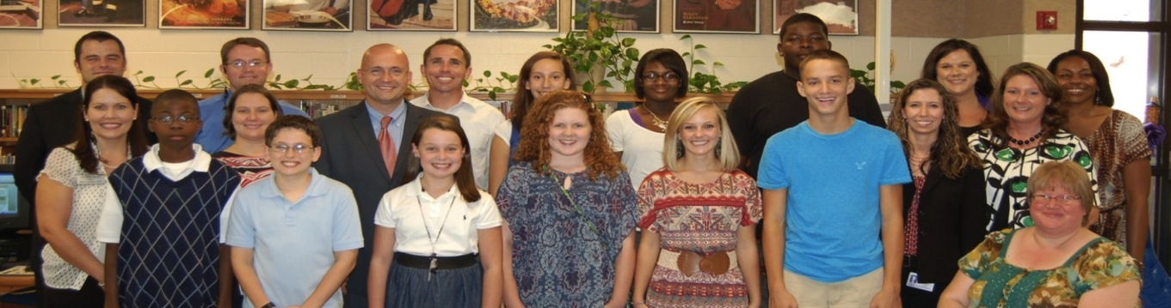
Collaborative Leadership
SBLT, School Council, PTO
Principal’s Student Leadership Council
Striving to Reach and Motivate Students

Slide 6
Collaborative Leadership

Slide 7
Collaborative Leadership
What role does collaborative leadership play in school leadership?
What is your school doing to promote collaborative leadership with the following groups?
  Students
  Staff
  Other Stakeholders (parents, businesses, community)
How are you going to improve what your school is doing to promote collaborative leadership?
What are the greatest challenges to implementing effective collaborative leadership?

Slide 8
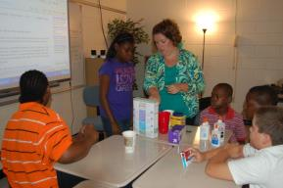
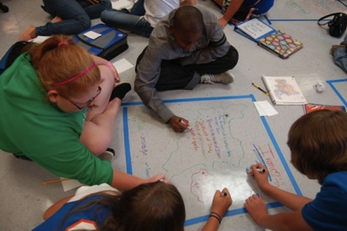
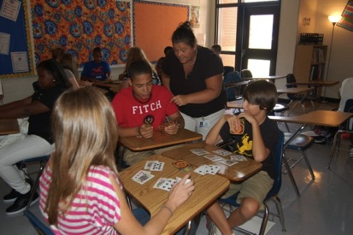
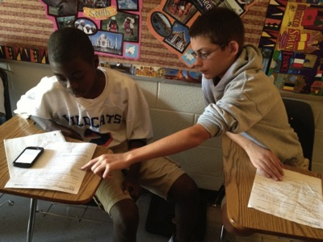
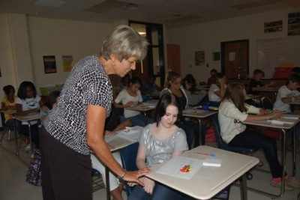
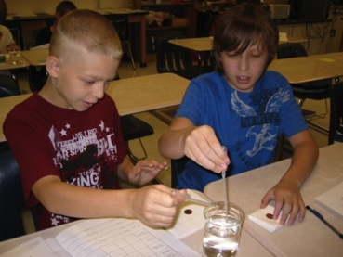
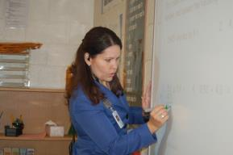
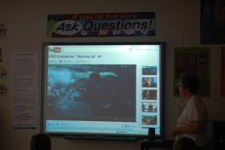
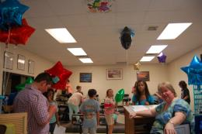
Personalization
Weekly Classroom Visits
Striving to Reach and Motivate Students

Slide 9
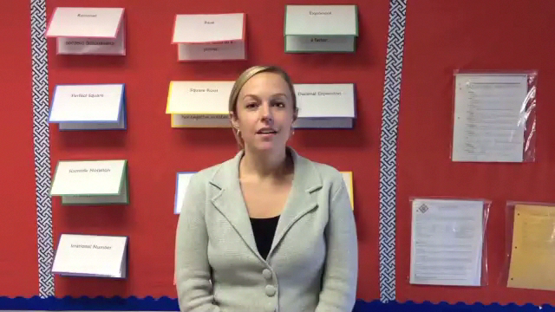
Personalization
Striving to Reach and Motivate Students

Slide 10
Personalization
Striving to Reach and Motivate Students

Slide 11
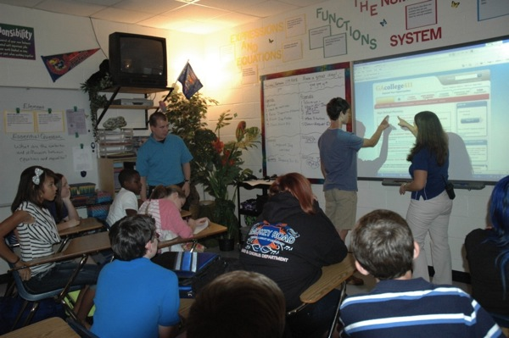
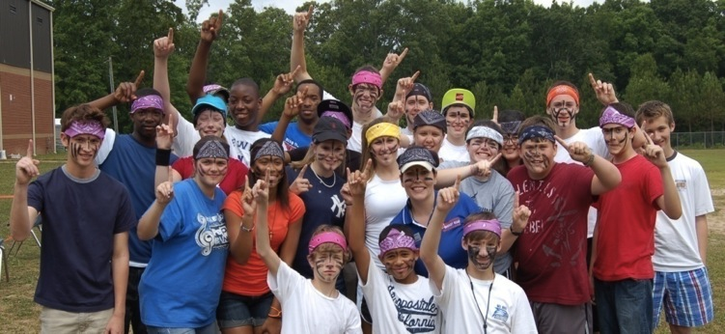
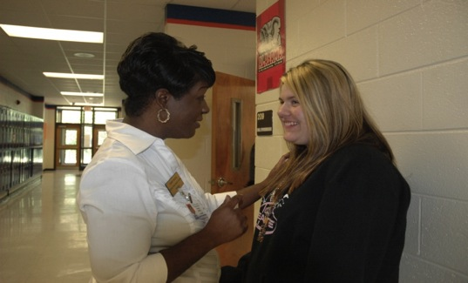
Personalization
Homeroom Buddies
Tracking Student Attendance
Striving to Reach and Motivate Students

Slide 12
Personalization
Striving to Reach and Motivate Students

Slide 13
Personalization
Striving to Reach and Motivate Students

Slide 14
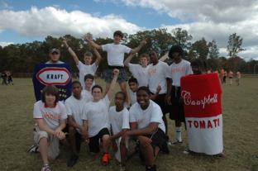
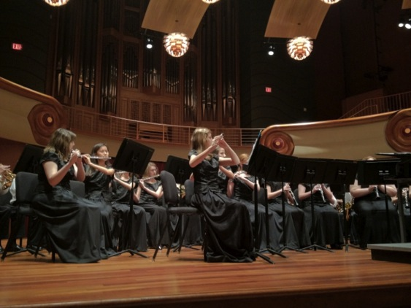

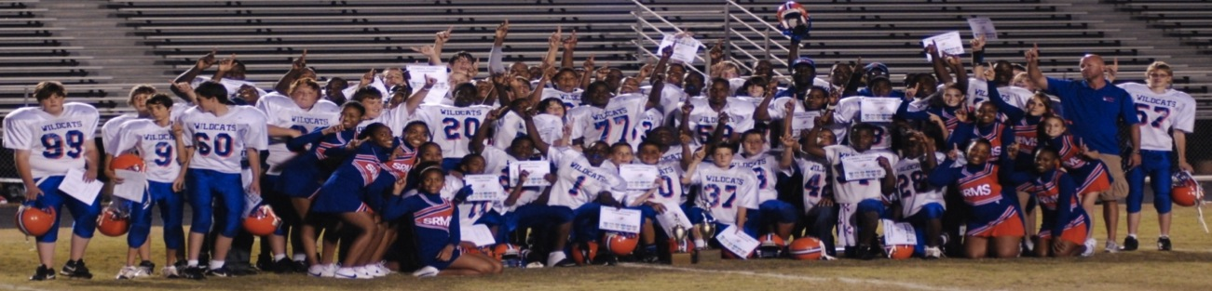
Personalization
Respecting All Students
Valuing What Students Value
Striving to Reach and Motivate Students

Slide 15
Personalization
Striving to Reach and Motivate Students

Slide 16
Personalization
Striving to Reach and Motivate Students

Slide 17


Personalization
Encouraging Positive Behavior
Purpose
The Smokey Road Middle School Encouraging Positive Behavior program is designed to foster a climate of safety, success, cooperation, academic excellence, responsibility, and respect for everyone who enters our doors. We believe that all Smokey Road Wildcats should uphold the Standards for Student Success at all times.
Standards for Student Success
Continue to Succeed
Achieve Learning Goals
Take Responsibility
Show Respect

Slide 18
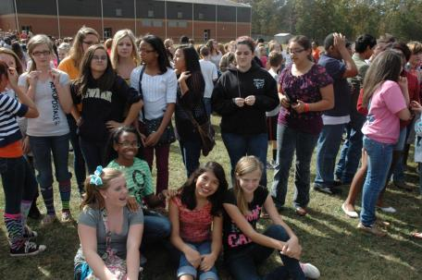
Personalization
Classy CATS Days
Students must be passing ALL classes and having NO discipline referrals for each time period listed below.
Eligibility Dates | Classy CATS Date
August 6 – September 11 | September 12
September 12 – October 18 | October 19
October 19 – November 15 | November 16
November 16 – January 7 | January 8
January 8 – February 8 | February 11
February 11 – March 21 | March 22
March 22 – April 29 | April 30
AUGUST 6 – MAY 12 | May 13

Slide 19
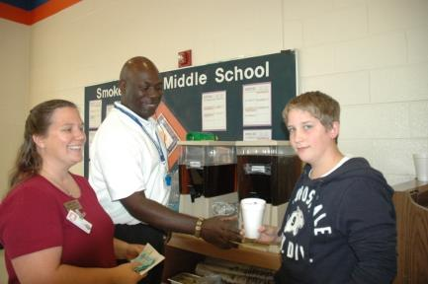
Personalization
CATS Cash
1 CATS CASH
Name Entered in Monthly Drawing (for items listed below)
Positive Phone Call Home from Staff Member of Your Choice
5 CATS CASH
Free School Pen
Free Slushy, Cookie, or Iced Tea at Lunch
Free Candy or Drink at Smokey Road Event
10 CATS CASH
Eat Lunch with a Friend in Lunchroom (same grade level)
Free Item from the School Store
15 CATS CASH
Free Smokey Road Athletic Event or Dance Pass
20 CATS CASH
Free School Spirit Item
30 CATS CASH (for all students who earn at least 30 CATS CASH for semester)
CATS Cash Celebration

Slide 20
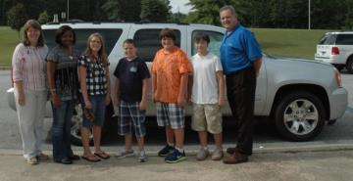
Personalization
SouthTowne Recognition Program
Citizenship Award | Who: Five Students Awarded Monthly
 | Criteria: Outstanding Citizenship Displayed for the Entire Month
 | Indicators Include: Honesty, Respect, Responsibility, Compassion, and Cooperation
 | Selected by: Grade Level and Connections Teachers
 | Award: Transported to Lunch off Campus at All-You-Can-Eat Buffet
Academic Excellence Award | Who: Two Students per Team Awarded Monthly (16 students total)
 | Criteria: Academic Excellence Displayed for the Entire Month
 | Indicators Include: Excellent Grades, Cooperation, Motivation, Perseverance, Teamwork
 | Selected by: Team Teachers
 | Award: Lunch Delivered in the Cafeteria
Attendance Award | Who: Recognized Monthly, Awarded Once per Nine Weeks to All Students Who Meet Criteria
 | Criteria: No Absences, No Tardies, No Early Check-outs for the Entire Nine Weeks Period
 | Selected by: Computer Generated
 | Award: Juice and Doughnuts Breakfast at End of Nine Week Period
Athletics/Arts Award | Who: One Student per Active Season Each Nine Weeks (13 students total)
 | Criteria: Athletic Excellence Displayed for the Entire Season
 | Indicators Include: Excellent Sportsmanship, Skill, Team Spirit, and Cooperation
 | Selected by: Athletic Coaches, Arts Directors
 | Award: School Spirit Items

Slide 21
Personalization

Slide 22
Personalization
What role does personalization play in school leadership?
What is your school doing to promote personalization with the following groups?
  Students
  Staff
  Other Stakeholders (parents, businesses, community)
How are you going to improve what your school is doing to promote personalization?
What are the greatest challenges to implementing effective personalization?

Slide 23
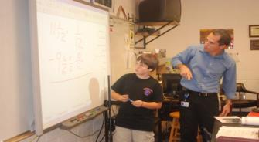
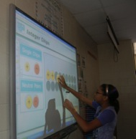
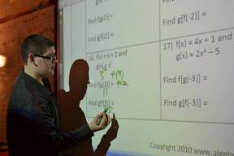
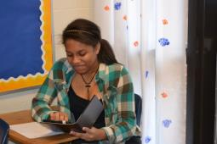

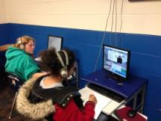

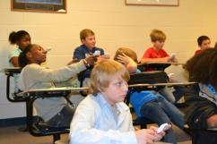
Curriculum, Instruction,
Assessment
Increasing Use of Technology by Teachers
Putting Technology in the Hands of Students
Bring Your Own Technology
Striving to Reach and Motivate Students
Notes:
23

Slide 24


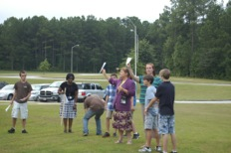
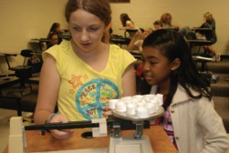
Curriculum, Instruction, Assessment
Special Education Services
Content Specialization
Special Education teachers specialize in a grade level subject.
Staying on Track
Teachers of special education resource classes teach the same grade level subject in a co-teach environment, ensuring that the resource class stays on track with grade level peers.
Striving to Reach and Motivate Students

Slide 25
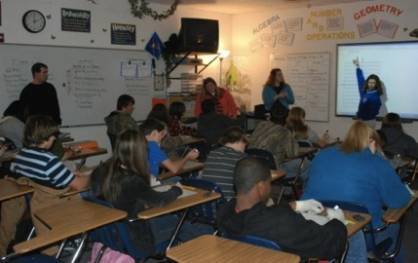
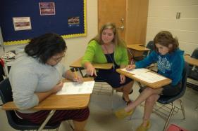
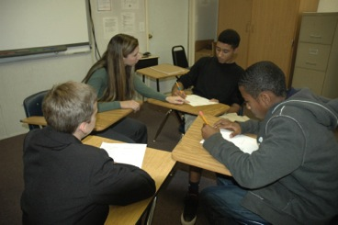
Curriculum, Instruction, Assessment
Three Teacher Math
Three Teacher Math is used in place of traditional separate and co-teach math classes.
Regular and special education students who struggle in math receive instruction from three certified math teachers (regular education, special education, and instructional coach) for 75 minutes daily.
Three teachers provide more one-on-one instruction and true flex grouping for remediation and acceleration as needed without removing students from instruction, all while educating special education students alongside their regular education peers.
Striving to Reach and Motivate Students

Slide 26
Curriculum, Instruction, Assessment
Striving to Reach and Motivate Students

Slide 27
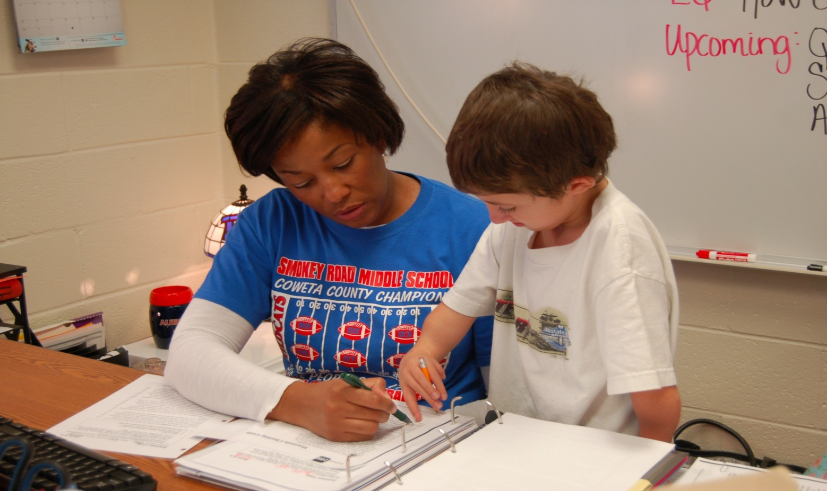
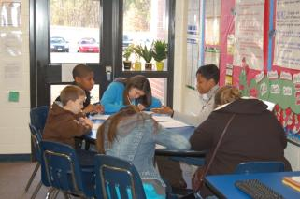
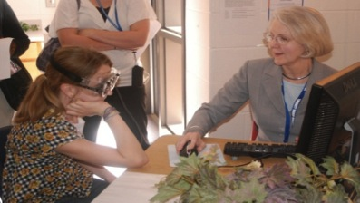

Curriculum, Instruction, Assessment
Separate Connections Classes
Students in the three teacher math class also participate in an additional separate math connections class as part of IEP services as needed for 45 minutes daily where teachers pre-teach and re-teach math content, giving struggling math students a total of 120 minutes of math instruction daily from four fully certified and highly qualified teachers.
A separate Reading class is also offered during connections time.
Striving to Reach and Motivate Students

Slide 28
Curriculum, Instruction, Assessment
Striving to Reach and Motivate Students

Slide 29
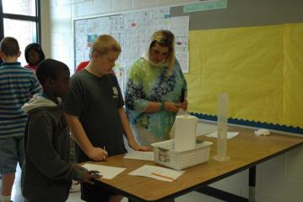
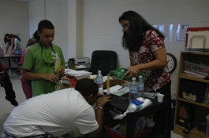
Curriculum, Instruction, Assessment
Co-Teach Model
Nationally, 57% of students with disabilities spend approximately 80% or more of their time in general education each day.
At Smokey Road, we gradually decreased separate resource classes in favor of more effective heterogeneous co-teach classes, while providing separate resource class services in addition to, not in place of, the general education class.
At Smokey Road, 85% of students with disabilities spend approximately 80% or more of their time in general education each day, with 100% spending at least 26% of their time in general education each day, including students receiving self contained services.
Striving to Reach and Motivate Students

Slide 30
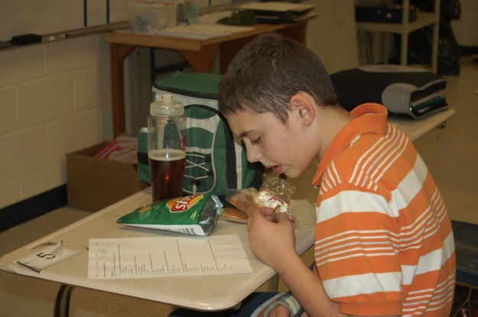
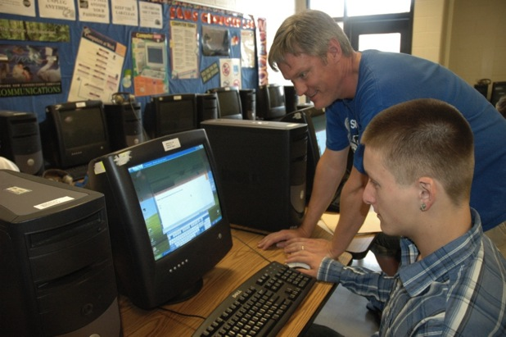
Curriculum, Instruction, Assessment
Lunch and Learn
Mastery Based Assessment Model
Grade Repair
Striving to Reach and Motivate Students

Slide 31

Curriculum, Instruction, Assessment
Curriculum → Instruction → Learner → Assessment
Everything is easier than meaningful assessment.
Meaningful, valuable questions are difficult and time-consuming to create.
Assessments students tend to value:
  Classroom Tests
  Advanced Placement (AP) Tests
  SAT
  ACT
Assessments “others” tend to value:
  State-required Tests
  NCLB-required Tests
  Smarter Balanced, PARCC
Nation
State
District
School
Classroom
Student
Graphic Courtesy of Paul Andersen, 2011 Montana Teacher of the Year

Slide 32
Curriculum, Instruction, Assessment
What role does curriculum, instruction, and assessment play in school leadership?
What is your school doing to promote curriculum, instruction, and assessment with the following groups?
  Students
  Staff
  Other Stakeholders (parents, businesses, community)
How are you going to improve what your school is doing to improve curriculum, instruction, and assessment ?
What are the greatest challenges to implementing effective curriculum, instruction, and assessment ?

Slide 33
Lead Your Students to Do More

Slide 34
Are You Stuck?

Slide 35
Our Results: Attendance
Percentage of Decrease in Absences
(absent more than 15 days)
Subgroup | 2003 to 2013
All | -11.9%
African American | -12.6%
Caucasian | -11.4%
Students with Disabilities | -14.5%
Economically Disadvantaged | -13.7%*
*EcD Data through 2012
Striving to Reach and Motivate Students

Slide 36
Our Results: Attitude
Percentage of Decrease in Referrals
 | 2009 to 2013
Decrease in All Referrals | -50%
Decrease in African American Referrals | -54%
Decrease in Caucasian Referrals | -43%
Decrease in Students with Disabilities Referrals | -67%
Decrease in Economically Disadvantaged Referrals | -44%
Striving to Reach and Motivate Students

Slide 37
Our Results: Academics
AYP Subgroup Academic Achievement Percentage of Improvement
 | Math | Reading/ELA
 | 2003 to 2013 | 2003 to 2013
All | +21.4% | +22.7%
African American | +33.1% | +33.8%
Caucasian | +15.5% | +17.3%
Students with Disabilities | +52.8% | +54.9%
Economically Disadvantaged | +18.4%* | +20.3%*
*EcD Data through 2012
Striving to Reach and Motivate Students

Slide 38
Our Results: Academics

Slide 39
Our Results: SWD Academics
88%
89%
80%
83%
83%
68%
60%
66%
66%
54%
45%
33%
41%
 | SWD | ALL
State | +29 | +13
Smokey Road | +53 | +29
22%

Slide 40
Traits of
High Performing Schools
“The Arizona Department of Education examined three years of statewide testing data to find the schools where students with disabilities improved academically year after year.”
“I'm not taking my daughter to get serviced. I'm looking for a great school."
High Expectations
Highly Effective Teaching Strategies
Data Driven Decision Making
Students Are Provided with Reteach and Enrichment Activities
Students with Disabilities Receive Core Instruction in the General Education Classroom
Effective Leadership
“Aha! Just as I suspected. A good school is a good school for all kids.”
Source: Karla Phillips Huff Post Education, with information the Arizona Department of Education

Slide 41
12 Quotes to Ponder
“Nothing of any importance has ever been accomplished by a pessimist.” Jack Welch
“There are no traffic jams along the extra mile.” Roger Staubach
“There will be haters, doubters, non-believers, and then there will be you, proving them wrong.” Anonymous
“The single greatest effect on student achievement is not race; it is not poverty – it is the effectiveness of the teacher” Harry Wong
“The real secret of success is enthusiasm. ” Walter Chrysler
“One person with passion is better than forty people merely interested.” E. M. Forster

Slide 42
12 Quotes to Ponder
“I would remove the phrase ‘You’re going to need this for the test’ from every school.” Teresa Williams
“You're never as good as everyone tells you when you win, and you're never as bad as they say when you lose.” Lou Holtz
“Kids don't learn from teachers they don't like.” Rita Pierson
“Our job is to teach the students we have. Not the ones we would like to have. Not the ones we used to have. Those we have right now. All of them.” Kevin Maxwell
“Teaching is not about the management of students to create an orderly classroom. Teaching is about building relationships with students to create a culture of learning.” Charity Stephens
“Every kid is one caring adult away from being a success story.” Josh Shipp

Slide 43
Be a Leader of Change
We can do it, together.

Slide 44
Visionary and Instructional Leadership
Dr. Laurie Barron
Superintendent
Evergreen School District
Kalispell, Montana
2013 MetLife/NASSP National Middle Level Principal of the Year
lauriebarron18@gmail.com
@LaurieBarron (Twitter)

