Slide 1
WV Cohort Meeting
December 1, 2016
Dr. Mary Lu MacCorkle
Teaching and Learning
Supporting Rigor

Slide 2
ISLLC Standard 2: An education leader promotes the success of every student by advocating, nurturing and sustaining a school culture and instructional program conducive to student learning and staff professional growth.
Functions:
A. Nurture and sustain a culture of collaboration, trust, learning, and high expectations
B. Create a comprehensive, rigorous, and coherent curricular program
C. Create a personalized and motivating learning environment for students
D. Supervise instruction
E. Develop assessment and accountability systems to monitor student progress.
F. Develop the instructional and leadership capacity of staff
G. Maximize time spent on quality instruction
H. Promote the use of the most effective and appropriate technologies to support teaching and learning
I. Monitor and evaluate the impact of the instructional program

Slide 3
PSEL Standard 4
Effective educational leaders develop and support intellectually rigorous and coherent systems of curriculum, instruction, and assessment to promote each student’s academic success and well-being.
Effective leaders:
a) Implement coherent systems of curriculum, instruction, and assessment that promote the mission, vision, and core values of the school, embody high expectations for student learning, align with academic standards, and are culturally responsive.
b) Align and focus systems of curriculum, instruction, and assessment within and across grade levels to promote student academic success, love of learning, the identities and habits of learners, and healthy sense of self.
c) Promote instructional practice that is consistent with knowledge of child learning and development, effective pedagogy, and the needs of each student.
d) Ensure instructional practice that is intellectually challenging, authentic to student experiences, recognizes student strengths, and is differentiated and personalized.
e) Promote the effective use of technology in the service of teaching and learning.
f) Employ valid assessments that are consistent with knowledge of child learning and development and technical standards of measurement.
g) Use assessment data appropriately and within technical limitations to monitor student progress and improve instruction.

Slide 4
Why are we concerned with rigor?
Talk with your group--

Slide 5
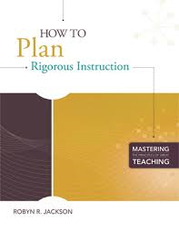
What are some reasons to care about RIGOR?
Rigor fosters persistence.
Rigor fosters resilience.
Rigor fosters flexibility.
Rigor fosters purposefulness.
Rigors fosters metacognition.
Rigor fosters ownership.
Notes:
2 minutes
According to Robyn Jackson, How to Plan Rigorous Instruction, these are a few reasons to pursue rigorous instruction for you and your students:
Persistence: When students must dig for the answers, they discover the value of the search.
Resilience: When students learn to engage in rigorous thinking and inquiry, they learn how to manage and work through frustration to solve problems on their own.
Flexibility: Rigorous instruction helps students grasp that learning is messy and unpredictable.
Purposefulness: Students come to see that they are learning in order to make meaning, to broaden their own understanding, and to solve interesting problems.
Metacognition: Rigorous instruction asks students to think about their learning goals, select appropriate strategies for pursuing those goals, and reflect on them.
Ownership: When students must make meaning for themselves, they come to own what they have learned.

Slide 6
Define Rigor
In your group, create a definition of rigor and provide an example of what it looks like in the classroom.

Slide 7

What is RIGOR?
Rigor is creating an environment in which each student is expected to learn at high levels, each student is supported so he or she can learn at high levels, and each student demonstrates learning at high levels. (Blackburn, 2008)
Notes:
5 minutes
So, we have talked about why we believe rigor is important. In Alabama we have standards and assessments that are rigorous. We agree that we want more rigorous instruction. Now lets look at what Rigor means. There are a lot of definitions of rigor out there. Let’s look at one of those definitions from Barbara Blackburn in her book Rigor Made Easy.
Handout #1:
Ask participants to read the definition and note words and phrases that resonate with them. After about a minute have participants discuss with a table partner.
Drop in and listen to discussion. Bring these points out at the end of the discussions.
This definition has 3 main parts:
Creating an environment where each student is expected to learn at high levels,
each student is supported so he or she can learn at high levels,
and each student demonstrates learning at high levels
This tri-fold definition is not limited to the curriculum students are expected to learn. It is more than a specific lesson or instructional strategy. It is deeper than what a student says or does in response to a lesson. True rigor is the result of weaving together all of these elements to raise students to higher levels of learning.

Slide 8
Rigor and Relevance
Willard R. Daggett, Ed.D.
K
N
O
W
L
E
D
G
E
T
A
X
O
N
O
M
Y
Evaluation
6
5
4
3
2
1
C
Assimilation
D
Adaptation
Synthesis
Analysis
Application
A
Acquisition
B
Application
Understanding
Awareness
Apply to real-world
unpredictable
situations
1 2 3 4 5
Knowledge
Apply in
discipline
Apply
across
disciplines
Apply to
real world
predictable
situations
APPLICATION MODEL
Notes:
Talk about the Application contimuum.

Slide 9
Rigor and Relevance
Rigor
Quadrant A
Gather and store bit of knowledge and information. Primarily expected to remember or understand this knowledge
A
Example:
Pick the right definition
Relevance
Source: International Center for Leadership in Education
Notes:
Let’s look at each quadrant separately.

Slide 10
Rigor and Relevance
Rigor
Quadrant B
Apply knowledge in real-life situations
Example
Compare car lease to loan
B
Relevance
Source: International Center for Leadership in Education

Slide 11
Rigor and Relevance
Rigor
Quadrant C
Use knowledge to analyze and solve school-based problems and create solutions
C
Example
A Research paper
Relevance
Source: International Center for Leadership in Education

Slide 12
Rigor and Relevance
Rigor
Quadrant D
Apply knowledge and skills in complex ways to analyze and solve real problems and create solutions. Confront real-world unknowns.
D
Example
Participate in a debate
Relevance
Source: International Center for Leadership in Education

Slide 13
Relationship of Assessments to the Rigor/Relevance Framework
Quadrant C Assimilation
Quadrant D Adaptation
Primary
  Extended Response
  Product Performance
Secondary
  Process Performance
  Constructed Response
  Portfolio
  Self-reflection
  Multiple Choice
Primary
  Portfolio
  Product Performance
  Interview
  Self-reflection
Secondary
  Extended Response
  Process Performance
6
5
4
3
2
1
Quadrant A Acquisition
Quadrant B Application
Primary
  Multiple Choice
  Constructed Response
Secondary
  Process Performance
  Extended Response
  Self-reflection
Primary
  Process Performance
  Product Performance
Secondary
  Interview
  Constructed Response
  Multiple Choice
  Portfolio
  Self-reflection
1 2
3 4 5
Primary=Best Match Secondary=Also Appropriate
Notes:
The International Center for Leadership in Education as also been working with Assessment as it relates to the rigor and relevance Framework. What types of assessment are appropriate in each quadrant?

Slide 14
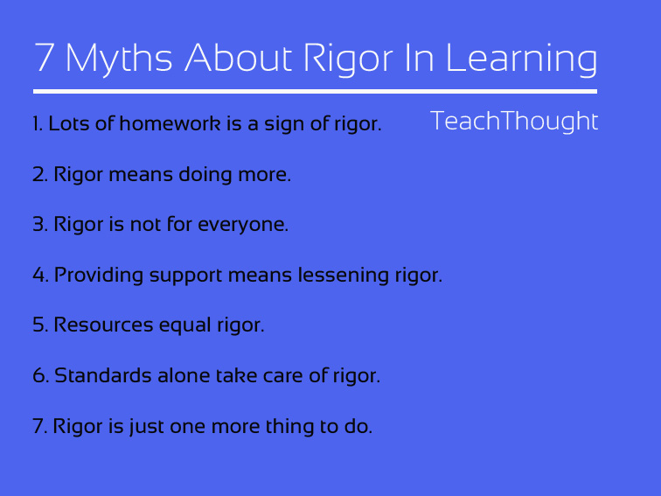

Slide 15
Two Conversations about Rigor
https://www.youtube.com/watch?v=iOcYfrZJWi8
https://www.youtube.com/watch?v=Fs3EL9CWTII

Slide 16
What are some of the components of Rigor?
1.Student engagement with the learning
2. Complexity
3. Quality Questions that ask students to analyze
4. Connection with DOK

Slide 17
Ink-Think
1. You will be assigned to a group begin with a specific component of rigor
Engagement

Slide 18
Ink-think
2. At your charts, SILENTLY, begin to create a web of words and phrases that describe your rigor component along with examples
3 minutes
Notes:
DOK 2-3

Slide 19

Ink-Think
3. When time is called, move to the next component and spend 2 minutes adding to the webs there
4. Do the same for the next two components when time is called
Notes:
DOK 2-3

Slide 20
Ink-think
5. Return to your original component chart. Work together to choose 2 main ideas that describe your level and 2 “perfect” examples.
6. Report out
Notes:
25-30
DOK 3

Slide 21
Student Engagement

Slide 22
3 kinds of student engagement
Rigor focuses on the Cognitive
Cognitive
Physical
Emotional

Slide 23


There are 2 components of Student Engagement:
Attention
              Engagement
Marzano & Pickering, The Highly Engaged Classroom, 2011

Slide 24
Higher Order/Deeper Engagement
Analysis, Critical Thinking, Problem Solving, Decision Making or Application from Analysis, Synthesis
-------------------- vs. -------------------------
Not Higher Order/Surface Engagement
Recall, Memorization, Fact Finding, Simple Understanding, Practice to Internalize Skills or Processes
Dr. Jerry Valentine

Slide 25
RUBRIC for IPI
Student-Engaged Instruction
6 – Student active engaged learning - HO
5 – Student learning conversations – may be teacher stimulated but not teacher dominated – HO
________________________________________
Teacher-Directed Instruction
4 – Teacher-led instruction – Not HO
3 – Students doing seatwork, etc. but teacher assistance/support is evident – Not HO
________________________________________
Disengagement
2 – Students doing seatwork, etc. but teacher assistance/support not evident – Not HO
1 – Complete disengagement – students not engaged in learning related to curriculum
Dr. Jerry Valentine

Slide 26
What does a classroom look like when students are engaged in active, rigorous learning?
Work with your group to list things you might see in an engaged, rigorous classroom.

Slide 27
Complexity

Slide 28
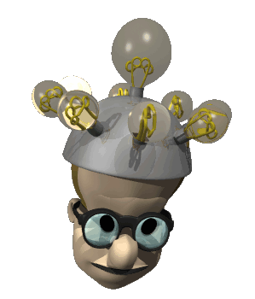
Complexity vs. Difficulty
Once a student knows how to add with ease, adding 649,228 and
934,058
is difficult but not
complex.

Slide 29
Cognitive Complexity
Look at the handout with your partner.
How would looking at Revised Bloom’s and DOK help teachers understand how to create lessons that meet the level of West Virginia’s standards?

Slide 30
Quality Questions

Slide 31


Questioning Books by Jackie Walsh and Beth Sattes

Slide 32

How Familiar is this Picture?
Listen to the Walk-about results from Well-Intentioned School. As you listen, think about the following questions:
Which is most troubling?
Which is most familiar?
Which one, if changed, would most affect student learning and thinking?
Record your responses individually and silently
When signaled, discuss with a partner. Be prepared to share with the group.
Notes:
We have included a story about Well-Intentioned School as a handout called, “How Familiar is this Picture?” We are going to read the story aloud as you follow along—mostly to control the pace of reading so that we all finish at the same time.
It’s a story of the results of Walkthroughs in this school. The results have to do with questions and questioning behaviors. And, we want you to know, these results are based on research findings over many years. They represent typical practice in K-12 schools in this country.
As you hear the results, we want you to think about the questions on the overhead and at the bottom of the handout page.
Which of these results—if found in your school—would be most disturbing or troubling to you, as a school leader?
Do any of them seem familiar?
Speculate as to why these data are typical for most schools. What philosophy of schooling do they represent?
In your opinion, which one would be most important to change—because it would be most likely to impact student learning?
Read the story. You may want to recruit participants to help you read…reading alternating findings, for example. When you are finished, ask the groups to discuss the questions for 5-7 minutes (you judge the time needed) and have some brief sharing.

Slide 33
Does this sound familiar?
Walk about results:
  82% of questions—remember
  88% of questions were asked of 1 student
  Wait time 1 was used 20 out of 500 obs.
  Wait time 2—2 times
  When no answer: repeated the question, rephrased it or answered it
  40% of questions answered incorrectly or incompletely—no feedback
  Walsh & Sattes, 2013

Slide 34

Norms: Purposes of Questioning
Students need to understand the purpose of questions:
Use teacher questions to prompt your thinking, not to guess the teacher’s answer.
Use mistakes as opportunities to learn: This is a risk-free classroom.
Use follow-up questions to think about and self-assess your first responses and to modify or extend your thinking.
Walsh & Sattes, 2013
Notes:
You may want to display this slide after pairs have gotten into their discussions so that all can see all three of the norms.
Move to the next slide to give directions for the next step.

Slide 35
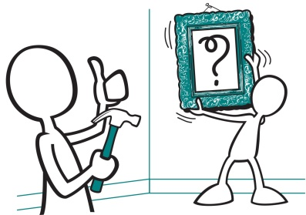
Instructional Function: Add Rigor and Relevance
Calculate the area of a rectangle that is 8 feet by 4 feet.
Imagine that you and a friend want to create a dog run, where his dog can play. You have 24 feet of fencing. Think of three possible shapes you could create in which the dog could play and run. Which of the three would provide the greatest area in which the dog could run and play?
Walsh & Sattes, 2013

Slide 36
Increasing the Cognitive Complexity of a Math Question
The Smith family has three children, aged 5, 7, and 9. What is the average age?
The Smith family has three children. Their average age is 7. What might be the ages of the children? Be ready to defend your answer.
Walsh & Sattes, 2013

Slide 37
Changing the Context
Is 52 an even number?
Write down 4 even numbers and one odd number. Ask your partner to identify the even numbers. Check his work. If you disagree, provide a rationale.
Walsh & Sattes, 2013

Slide 38

Changing the Rules and the Roles of the Game
Traditional classroom questioning can be compared to a baseball game. The TEACHER plays the roles of: pitcher, catcher, umpire, base players, and outfielders.
The STUDENTS? One at a time, they come up to bat; take a swing (sometimes hit and sometimes miss); then go back to sit on the bench until it’s their turn to bat again.
Who’s engaged all the time?
Walsh & Sattes, 2013
Notes:
Traditional classroom questioning is often called I-R-E. The teacher initiates a question, the student responds (one student at a time), and the teacher evaluates the response as to its correctness.
Walsh and Sattes liken this IRE classroom to a baseball game. But let’s look at who gets to play. Who pitches the questions? (the teacher in most classrooms is the pitcher.) The teacher is also the catcher and umpire; plays 1st, 2nd, and 3rd base—and fields the responses in the outfield too.
What are students doing in this old paradigm game? They sit on the bench and go up to bat one at a time; typically they get only one swing and then sit down. And some of those students never even get to bat; some students get to swing at almost every question!
So: who’s engaged all the time?
(expect a choral response: the teacher!)

Slide 39
Changing the Rules and the Roles of the Game
Quality questioning classrooms engage all players: in pitching questions, batting (answering) in cooperative response formats, fielding the responses, and throwing follow-up questions to one another.
This requires that all stay alert and engaged all the time!
Walsh & Sattes, 2013
Notes:
We’d like to change up the rules and the roles of the game and see students pitching (or asking questions); students fielding others’ responses; students playing infield, catcher, and as they reflect and self-assess, even umpire.
In this more active role, can you see that students will be more engaged?

Slide 40
https://www.teachingchannel.org/videos/open-ended-questions-ousd

Slide 41
Connection to DOK

Slide 42
What do we know about DOK?

Slide 43
DOK Sort
1. Sort the activity descriptions into DOK 1, 2, 3, or 4.
2. What do you notice about the items in each category? How would this activity help classroom teachers understand DOK and rigor?
3. Once you and your partner(s) have completed the sort, you will receive the answer sheet.

Slide 44
What do we do as administrators to ensure rigor in the classroom?
Observations/walkthroughs
Lesson plan checks (see articles)
10 minute meetings
PLC monitoring
Coming up with a common definition of what rigor looks like in the classroom

Slide 45
Jigsaw
Work with your group to jigsaw your articles. Each person will identify 2-3 important ideas from the assigned section. Then, as a team, put together a short summary/presentation to share with the other groups. Focus on how what you learned is helpful for an administrator.

Slide 46
What am I going to do with these thoughts about Rigor?
Take a few moments and think about your school and what assistance your teachers might need with rigor.
What strategy could you use to ensure that the instructional program at your school has sufficient rigor? How would you implement that strategy?

