Slide 1
Management Skills
February 20, 2018
WV Cohort
Dr. Mary Lu MacCorkle

Slide 2
Revisit Vision
In your mentor groups, share the vision that you created after our last meeting and discuss what insight your principal (or other administrator) provided you.

Slide 3
PSEL Standard 9
PSEL Standard 9 (12 elements)—Effective educational leaders manage school operations and resources to promote each student’s academic success and well-being.
ISLLC Standard 3 (5 functions)—Ensuring management of the organization, operation, and resources for a safe, efficient, and effective learning environment.

Slide 4
Principal Responsibilities
Vision
Instruction
Communication
Decision Making
Management
Culture/Climate
Relationships
Growth of everyone in the school
Do any of these overlap?

Slide 5
GITZ
What does Management mean to you? What areas are involved in the management of a school? How does it differ from Instructional Leadership or Visionary Leadership?
Use the chart paper to list all of the elements of Management in a school.

Slide 6

What comes under the umbrella of “Management?”
Safety
Finance
Communication
Schedules (all kinds)—Time management
Processes and Procedures
Political awareness and community relations
Personnel

Slide 7
Finance
Budget
Fundraising
Athletics (secondary)
PO process
Process for handling money/checks taken in

Slide 8
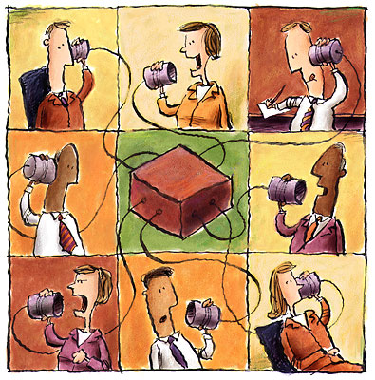
What does communication look like at your school?

Slide 9
Communication
Staff
Students
Parents
Community
Central Office
Public Relations
Have a communications plan—who, when, how often, how and who’s in charge?

Slide 10
Political Awareness and Community Relations
Trust
And Communication

Slide 11
Personnel
Hiring
Firing
Providing Consequences for poor behavior
Supervising/Monitoring
Evaluating
Building relationships and collaboration

Slide 12
Processes and Procedures
How does everything work? How do you make sure everyone understands how it works? Whose job is it to see that things run smoothly?

Slide 13
Lezotte’s 7 correlates of effective schools
Instructional Leadership
Clear and Focused Mission
Safe and Orderly Environment
Climate of High Expectations
Frequent Monitoring of Student Progress
Positive Home-School Relations
Opportunity to Learn and Student Time on Task

Slide 14
Daniel Goleman
1. Coercive—the leader demands compliance. (“Do what I tell you.”)
2. Authoritative—the leader mobilizes people toward a vision. (Come with me.”)
3. Affiliative—the leader creates harmony and builds emotional bonds. (“People come first.”)
4. Democratic—the leader forges consensus through participation. (“What do you think?”)
5. Pacesetting—the leader sets high standards for performance. (“Do as I do, now.”)
6. Coaching—the leader develops people for
the future. (“Try this.”)

Slide 15
What is the difference between management and leadership? How do you exhibit both effectively?
How does each impact student learning?
Give examples.

Slide 16
Student Safety
Talk in your groups about what measures your school takes to ensure the safety of students and staff. What do you know about your school’s crisis plan? How much practice takes place? Do all teachers and students know what to do?

Slide 17
School Crisis Scenarios
Each “team” will receive a different, multi-step scenario. Work through each module and questions (one at a time).
You have 20 minutes to complete the exercise. Be prepared to share with the rest of the “teams.”

Slide 18
Time Management--Scheduling
What challenges exist in your school that are created because of scheduling issues?

Slide 19

Student-Focused Schedules
The most important aspect of managing time in your building is to construct a master schedule that works for maximizing student learning.

Slide 20
Essential Question
How do schools build schedules to create time for faculty collaboration and to facilitate academic interventions?

Slide 21
The Purpose of the Master Schedule . .
..is to arrange the allotted time, staff, students, and physical resources together so that optimum learning will take place.

Slide 22
Number 1 Priority
Provide students with maximum opportunities for receiving the instruction needed for mastery AND learning (including intervention and enrichment)

Slide 23
Principal’s Responsibility
Before the school year begins you, as the instructional leader, have 2 primary responsibilities:
1. Hire the best teachers possible
2. Create a schedule in which student needs can be met in an efficient, thoughtful way

Slide 24
Adult-Centered Schedules vs. Student-Centered Schedules
Read the descriptors
Discuss the questions that follow
Report out

Slide 25
Questions
What challenges do your schools face in developing student-centered schedules? Brainstorm possible solutions.
What is the current process for developing master schedules in your county’s schools?
How can/does your county support schools as they develop their schedules?
Turn to your partner

Slide 26
6 Key Concepts for Scheduling
1. The schedule is a reflection of the philosophy, mission and vision of a school

Slide 27

6 Key Concepts for Scheduling
2. The principal must take the lead in schedule development

Slide 28
6 Key Concepts for Scheduling
3. The schedule must be based on the needs of the students

Slide 29
6 Key Concepts for Scheduling
4. The master schedule must support collaboration

Slide 30
6 Key Concepts for Scheduling
5. A practical, fair, efficient schedule takes time and commitment to create

Slide 31
6 Key Concepts for Scheduling
6. The master schedule has a great impact on student success

