Slide 1
Framing Your Success: The Continuous Improvement Cycle
Overview: PowerPoint

Slide 2
Celebrations

Slide 3
Introductions

Slide 4
Tuesday, August 26
Welcome & Introductions
Ice Breaker
Connections Past and New
Your Plan
Framing Your Success
Relationship Building
Lunch
Giving Effective Feedback
http://www.ascd.org/publications/educational-leadership/sept12/vol70/num01/Seven-Keys-to-Effective-Feedback.aspx
Innovators around Effective Feedback
~ Stephen Ritz - South Bronx Teacher
http://www.ted.com/talks stephen_ritz_a_teacher_growing_green_in_the_south_bronx
Framing Your Success
My Plan ~ Next Steps

Slide 5
Today's Goals
Challenge what you think about leadership
Change the way you think as a leader
Off new directions in your actions as a leader
Leadership has changed because society has changed and students changed with it
The pace of change is increasing, but not in all areas of education…

Slide 6
Memoir
Legend has it that Hemingway was once challenged to write a story in only six words.
His response?

Slide 7
For sale: baby shoes, never worn.

Slide 8
So.. You're going to write your own 6 word Memoir and then….
1. Find a colleague.
2. Read their memoir.
3. Talk to them…
- Find out about their story
- Their life
- The connections

Slide 9
Be ready to:
Read your memoir
Share your partner’s story
Remember: six words, No more, no less

Slide 10
Last year…..
How can we slow down this year?

Slide 11
Compare The Two Questions On The Next Slide
Read each question
Individually identity the differences between the two questions
What specific skills are embedded in each question
Once you have made your assessment share your thoughts with your neighbor
Be prepared to share with the group

Slide 12
Comparison (5th grade Example)
Question A:
Randa ate 3/8 of a pizza, and Marvin ate 1/8 of the same pizza. What fraction of the pizza did Randa and Marvin eat?
a. 5/8
b. 3/8
c. 1/4
d. 1/2
(Answer: d)
Question B:
Tito and Luis are stuffed with pizza! Tito ate one-fourth of a cheese pizza. Tito ate three-eighths of a pepperoni pizza. Tito ate one-half of a mushroom pizza. Luis ate five-eights of a cheese pizza. Luis ate the other half of the mushroom pizza. All the pizzas were the same size. Tito says he ate more pizza than Luis because Luis did not eat any pepperoni pizza. Luis says they each ate the same amount of pizza. Who is correct? Show all your mathematical thinking.
(Answer: Luis is right — both ate 1 1/8 of a pizza).

Slide 13
Why Are We Here?

Slide 14
Mentee Group

Slide 15
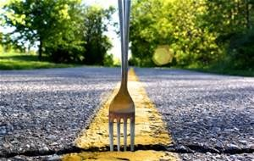
Next Steps….Division Groups

Slide 16
Are We Testing Too Much?

Slide 17
We Are Testing Too Much if…
We do not use the assessment’s results to inform our practice
We do not look at the assessment as an extension of the learning process, but rather as an end
We do not use the assessment as a tool for students to reflect on their own learning
We are unable to “purge” the files because we are clinging to units/assessments that are no longer relevant

Slide 18
Four Big Ideas
School effectiveness and leadership are measured primarily by learning results.
2. We have an obligation to lead us into the next effective platform for learning.
3. The single biggest factor in improved learning is the quality of teaching.
4. Leadership is second only to teaching among school influences on student learning.

Slide 19
Four Strategies:
Define learning and then ensure a viable curriculum.
Face the learning facts
Insist on teacher quality
Organize your school around learning
Leadership is Light and Heat,
providing direction, and:
exercising influence.

Slide 20
Where is my current leadership influencing student learning?
 | High, direct influence on student learning | Minimal, indirect impact on student learning
Reactive
Proactive

Slide 21
We all say that we measure the effectiveness of school through ‘learning’.
What is your school’s definition of learning?
Bing: Social Learning
Turn to your learning partner and talk about your definition

Slide 22
Common Core Standards including WHAT, WHETHER and HOW students learn, is a binding contract between the school, the parents and the learner, to which all are accountable.
When is the curriculum not guaranteed?

Slide 23
Yes or No
~Particular groups (or classes) of students fail to achieve to the level of those in other classes working with the same curriculum.
~The data from common assessments is persistently inconsistent.
~Parents consistently complain that their child is not doing the same kind of work as kids in other classes of the same grade.
~Teachers consistently use different criteria to assess the same type of task.
~Teachers feel free to substitute the tasks with what they are familiar with in the classroom.

Slide 24
When the curriculum is not viable….
Yes or No
~Year after year, teachers report there is not enough time to complete the intended curriculum.
~Too many students consistently fail to reach the expected standards for particular learning goals (Writing, PE, Speaking, etc.
~Department heads consistently ask for more time for their subject area.
~Teachers complaining of “curriculum overload”.
~Teachers complaining they cannot teach the standard due to lack of resources.

Slide 25
Standards for a Guaranteed and Viable Curriculum
Is understood to be the primary ‘contract’ that the school enters into with parents and their children.
Clearly indicates WHAT learning ALL learners will have access to.
Insists that all intended learning (expectations, standards) has value beyond school.
Is consistent with the latest understanding about how learning happens.

Slide 26
Standards for a Guaranteed and Viable Curriculum cont.
Clearly indicates evidence of learning.
Clearly indicates the essential learning experiences ALL learners will have equal access.
Is aligned (intended learning, assessment, instructional strategies, recording, reporting)
Develops content from best examples of the standards.
Sets high expectations for ALL learners.
Provide a way to continuously refresh the curriculum.
Lessons are planned backwards beginning with the ‘intended learning’ as evidence of learning.

Slide 27
EXAMPLE OF TEACHER STANDARDS An Effective faculty member at (school):
1: Sets and assesses high standards and is accountable for the achievement of all students.
2: Adheres to the school curriculum to maximize student learning of the school curriculum.
3: Teaches the (school) curriculum using the most effective and current strategies.
4:Pursues and applies professional development identified through reflective practice and coaching.
5: Collaborates in curriculum development and school improvement.
6:Demonstrates a positive approach to challenges and participates in school activities.
7:Models the schools values as stated in our Code of Professional Conduct.

Slide 28
. Check your mission – Anything about the individual child?
Key question: Under what conditions will EACH student best acquire this learning?

Slide 29
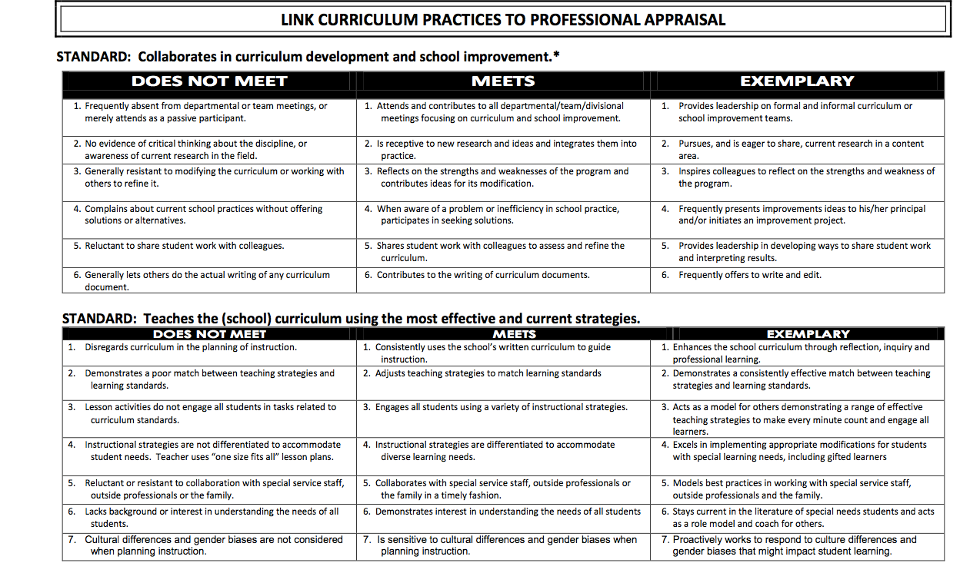

Slide 30
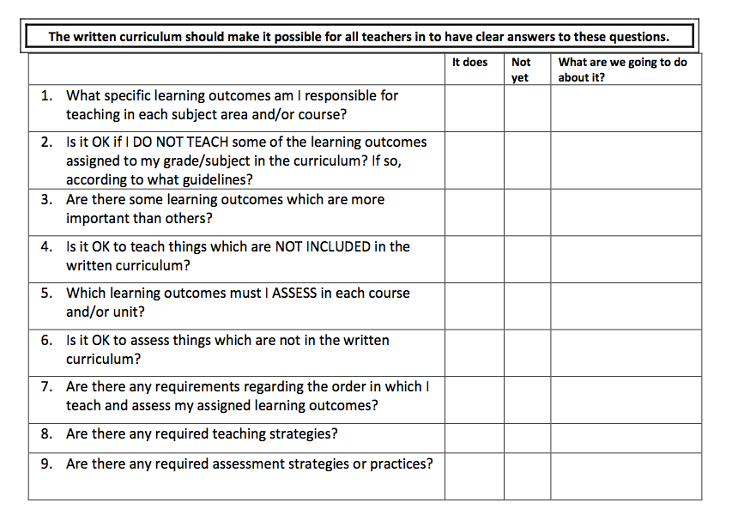

Slide 31
The Common Core… and Beyond

Slide 32
Research
A well-articulated curriculum aligned to standards is critical for student achievement (Marzano 2003, 2006)
Survey of enacted curriculum
Pervasive misalignment of standards and instruction (particularly the level of rigor (CCSSO, 2010)
50% of the variance in student achievement can be explained by the extent to which the curriculum, instruction, and assessment are aligned to state standards (CCSSO, 2004)
The best indicator of a person’s likelihood of succeeding in college is the standard of his/her high school curriculum (US Department of Education, 2008)

Slide 33
New Standards and the Reality of Change

Slide 34
Six Key Principles For Implementing the Common Core
Center on outcomes
Focus on the process to achieve the outcomes
Continuous improvement for all students
Collaborative and co-creative process
Interdisciplinary and relevant
Assessments for learning
Think 12 - K not K - 12

Slide 35
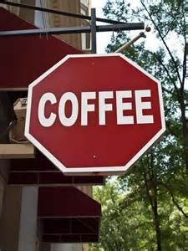
What are we going to start doing as leaders and what are we going to stop doing?

Slide 36
Take a few minutes to think.
START | STOP

Slide 37
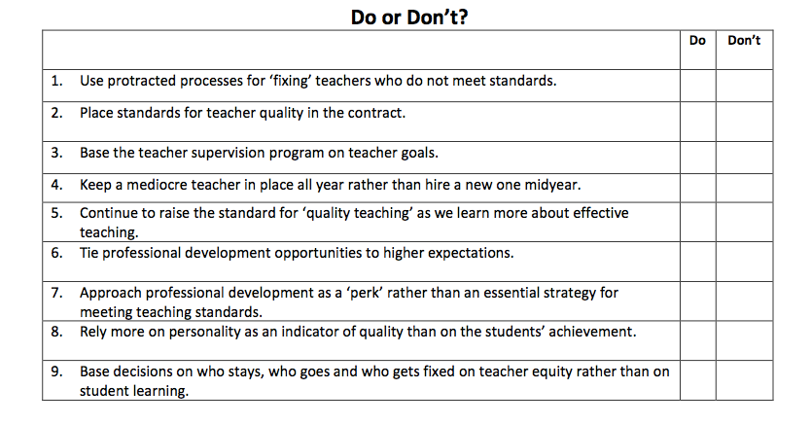
Insist on Quality Teaching…really

Slide 38
Find a division partner

Slide 39
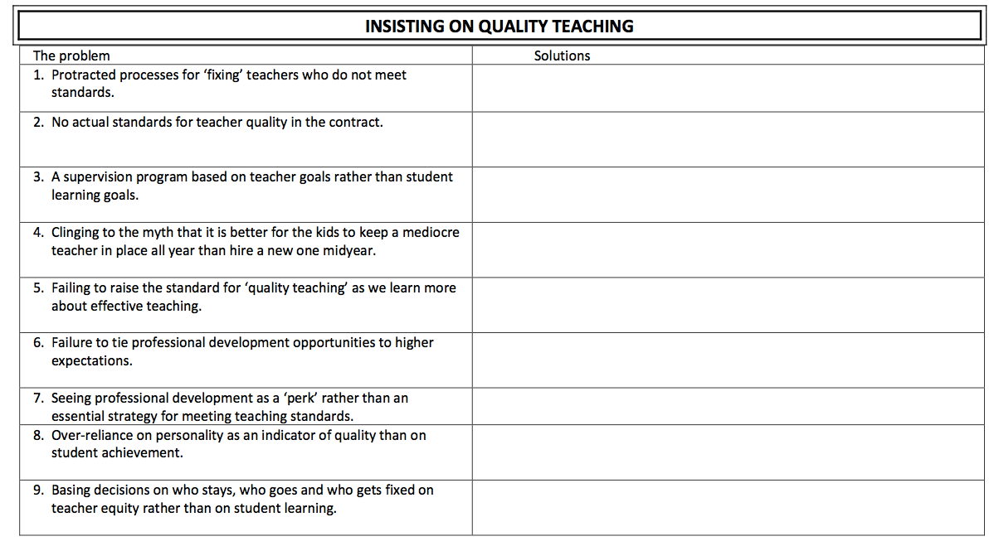

Slide 40
Framing Your Success: The Big Picture

Slide 41
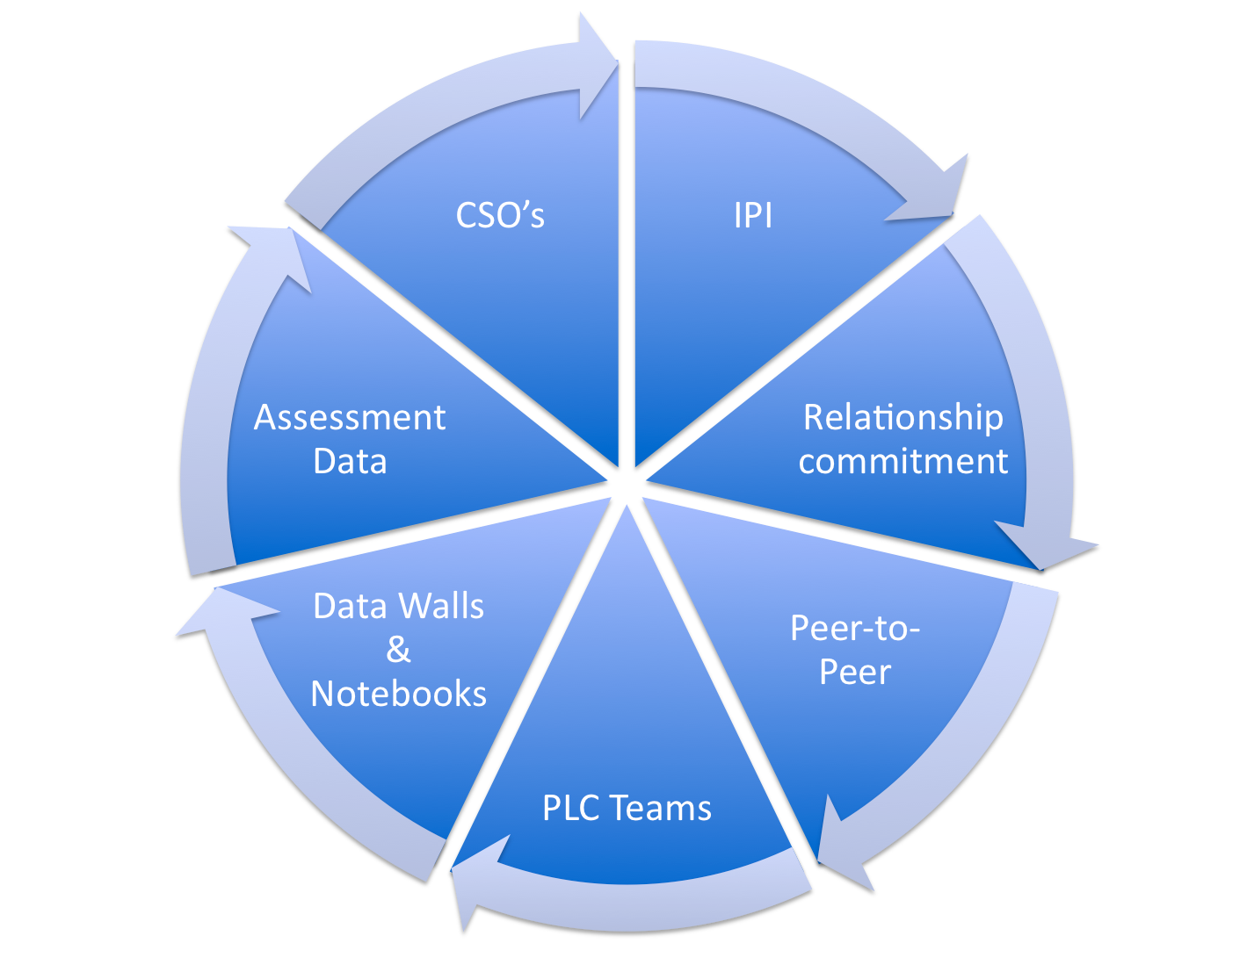

Slide 42
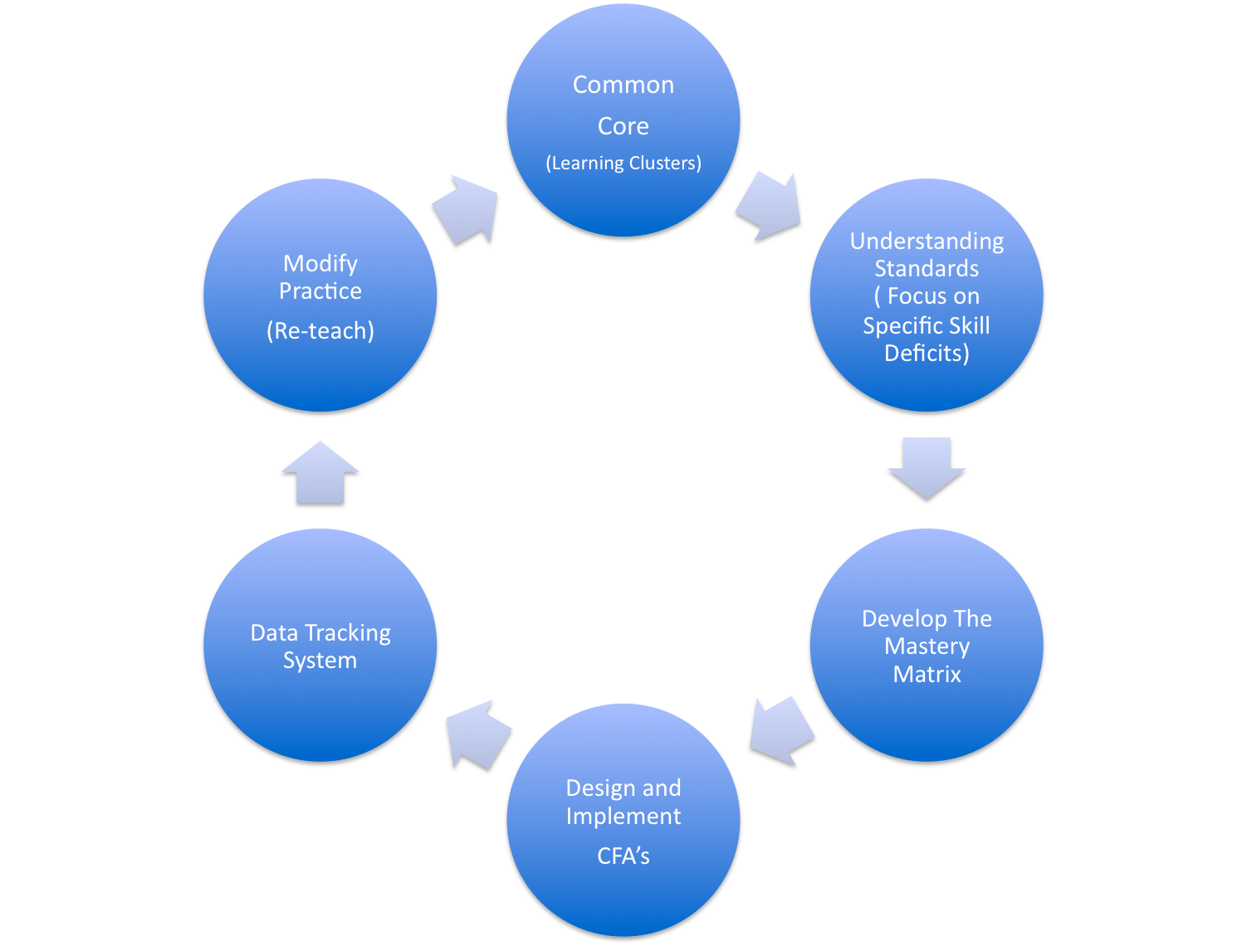
The Continuous
Improvement Process
The Edwards Model© 2012

Slide 43
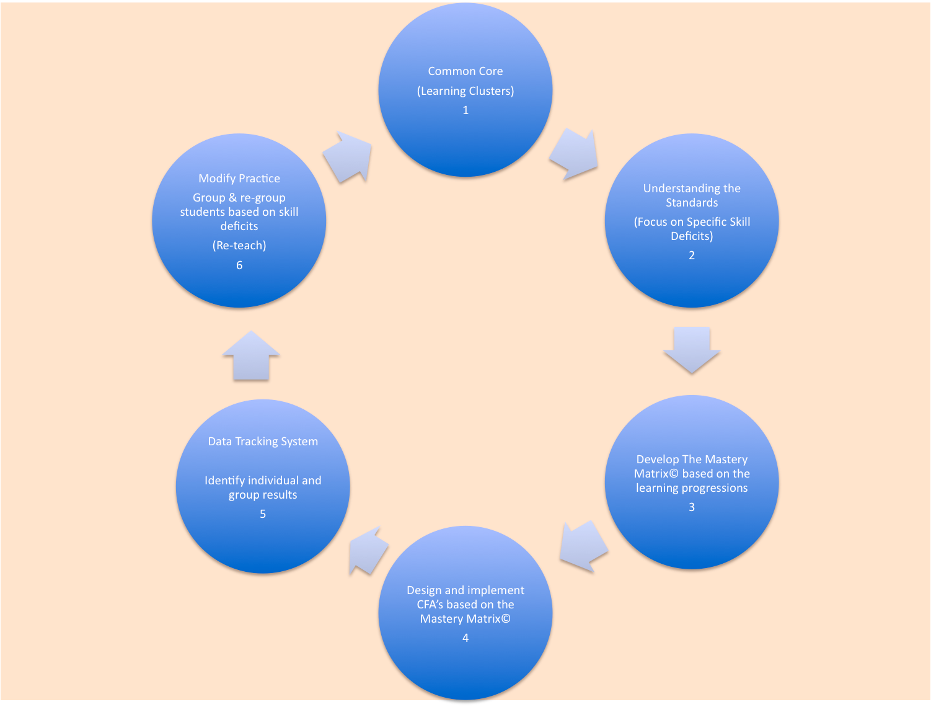
CC-WV Alignment Spreadsheet
At PLC Meetings
Determine
Strategies/
Interventions
Learning
Progressions (12-K
The Continuous
Improvement Model
Build Using
The Learning
Progressions
& Alignment
Spreadsheet
Monitor Progress
With SCA/Quick Hits
Use the Mastery Matrix As Questions
For SCA/Quick Hits/Lesson Planning
The Edwards Model Applied to WV© 2012

Slide 44
The Continuous
Improvement Process
The Challenge: In many cases we didn’t know the “old standards” and now we have “new standards”. All faculty MUST take ownership of the CCS.
The Edwards Model© 2012

Slide 45
The Continuous
Improvement Process
Understanding the standards with learning clusters, objectives and skills is critical. Knowing these and applying them are two different things. We must be able to diagnosis the derailer at the micro level.
The Edwards Model© 2012

Slide 46
Why Analyze Standards?
Although CCS have been written to be precise and clear, there is still room for multiple individual interpretations.
Standards are not meant to be mastered in one learning opportunity.
Educators and students require common and clear learning targets.
The rigor in the curriculum is identified in the skills students are learning, not the standard.

Slide 47
Analyzing The Standards Worksheet
What is the meaning /intent of the CSO? (What would it look like in the classroom? What would I see students doing?) Circle the content Underline the verb | What knowledge or understanding is necessary to master this standard? (explain, identify, tell, name, list, define, label, recall) | What reasoning (if any) is needed to demonstrate mastery of this standard? (analyze, compare/contrast, synthesize, classify, evaluate) | What performance skills (if any) are necessary to demonstrate mastery of this standard? (observe, listen, perform, so, work, read, speak, investigate?) | What produce capabilities (of any) are needed by this standard? (design, produce, create, develop, make, draw, display, construct)
Modified by Sarah King -- Cedar Grove Middle School

Slide 48
Universal Skills (cross all disciplines) and Content Skills as they relate to the Common Core

Slide 49
The Continuous
Improvement Process
Taking learning clusters and building a model to drive instruction is an essential
element of the process. The Mastery Matrix© is a tool for educators to work collaboratively with peers to examine concepts and skills and build an instructional framework.
The Edwards Model© 2012

Slide 50
The Mastery Matrix©

Slide 51
The Mastery Matrix has Multiple Functions

Slide 52
The Mastery Matrix Defined
To determine mastery of a skill or concept, two factors are essential:
Depth Of Knowledge (DOK) or Levels Of Complexity (LOC)
The ability to apply the skill or concept in multiple ways (The Rule of Threes) and at multiple levels
When students can apply skills and concepts in three different ways and at three different levels, the student has demonstrated the highest level of mastery.

Slide 53
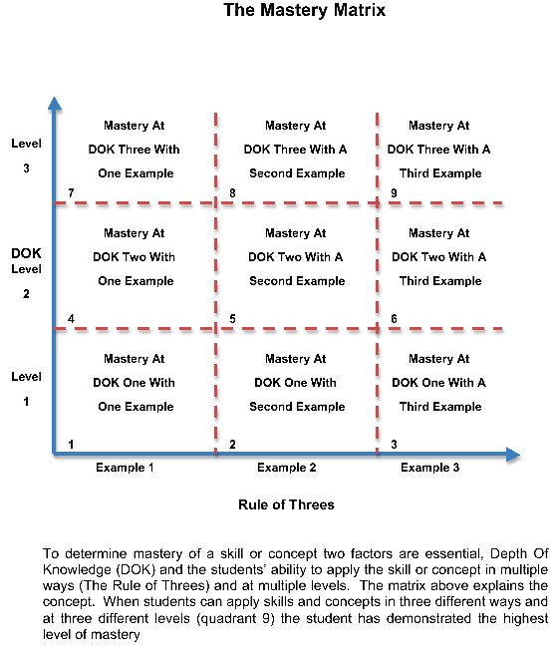
Property of Edwards Educational Services, Inc. May not be copied without the permission of the author

Slide 54
Level of Complexity 1 (DOK 1) | Level of Complexity 2 (DOK 2) | Level of Complexity 3 (DOK 3)
The student does not need to make a decision The student only needs to recall or recognize information | The student must be able to do more than memorize information S/he needs to understand concepts and make some decision S/he needs to mentally manipulate information in context (at a basic level) | Recognize problems Deduce their causes Devise solutions Determine significance Predict outcomes Identify next steps Justify response

Slide 55
Experiment Writing Your Own Matrix

Slide 56
The Mastery Matrix©
DOK
Level
3
DOK
Level
2
DOK
Level
1
Example 1 Example 2 Example 3
Rule of 3s
A Product of Edwards Educational Services

Slide 57
Report Out

Slide 58
Learning Styles
©2012, EES

Slide 59
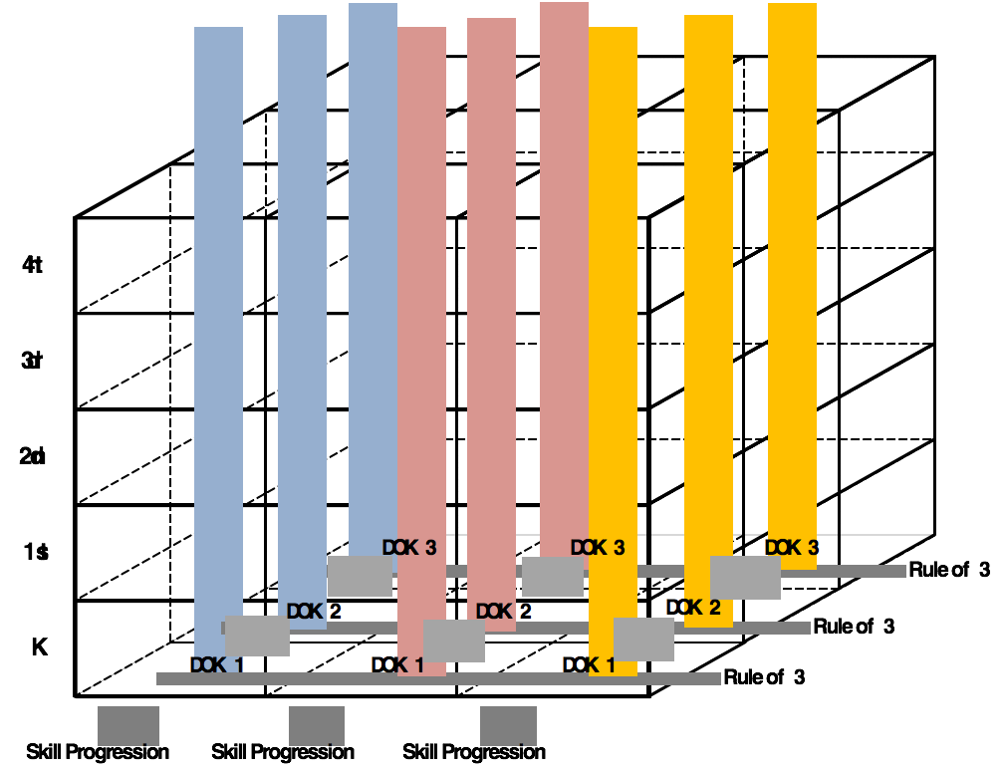

Slide 60
The Mastery Matrix©
DOK
Level
3
DOK
Level
2
DOK
Level
1
Example 1 Example 2 Example 3
Rule of 3s
A Product of Edwards Educational Services

Slide 61
The Continuous
Improvement Process
Common Formative Assessments (CFA) are regularly referred to in the literature (Center for Education, National Research Council, 2011)
as an important component of success with the CCS. These are assessments “for” learning that allow teachers to make adjustments in practice on a frequent basis. Developing CFAs is a key part of a well designed Assessment Map and contributes to a deeper understand of the standards and greater ownership on the part of teachers.
The Edwards Model© 2012

Slide 62
Are You Building CFAs At Your School?

Slide 63
Building A District Wide Assessment Map: Identifying Gaps
Summative Assessments | Benchmark Assessments | Short Cycle Assessments | Teacher Assessments

Slide 64
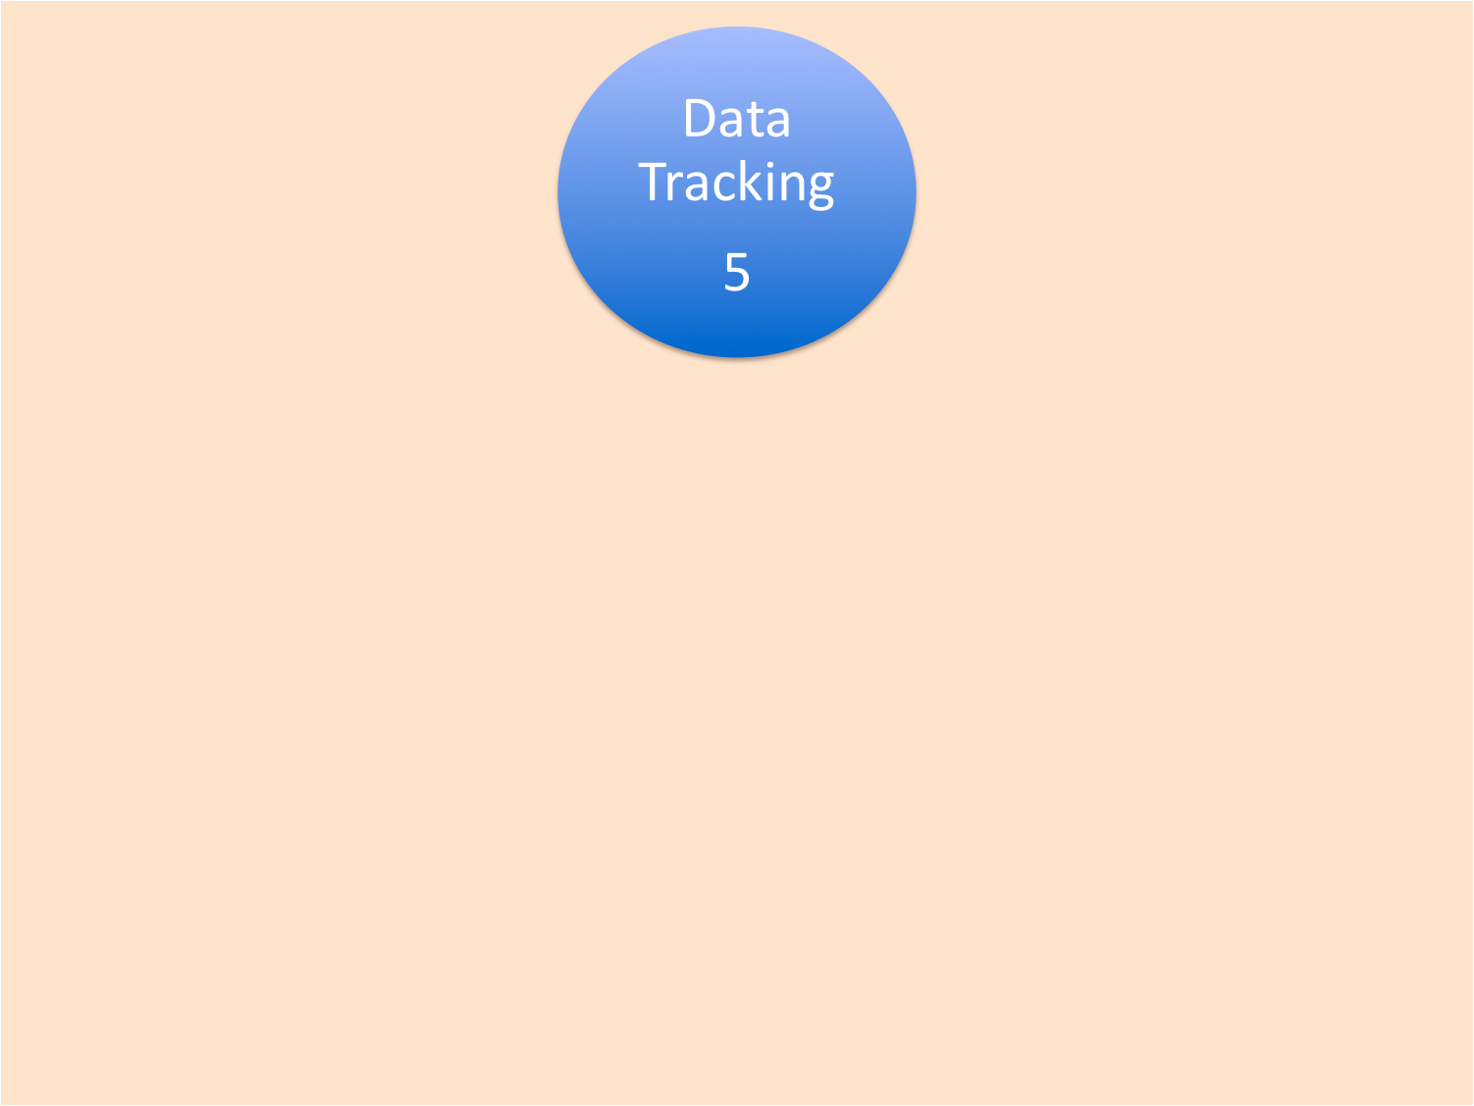
The Continuous
Improvement Process
Identifying students’ growth and gaps assists in informing teacher practice and allows for the sharing of best practices. This is most effective when it is done in a collaborative setting with multiple common data points. An important element of data tracking and analysis is student reflection.
The Edwards Model© 2012

Slide 65
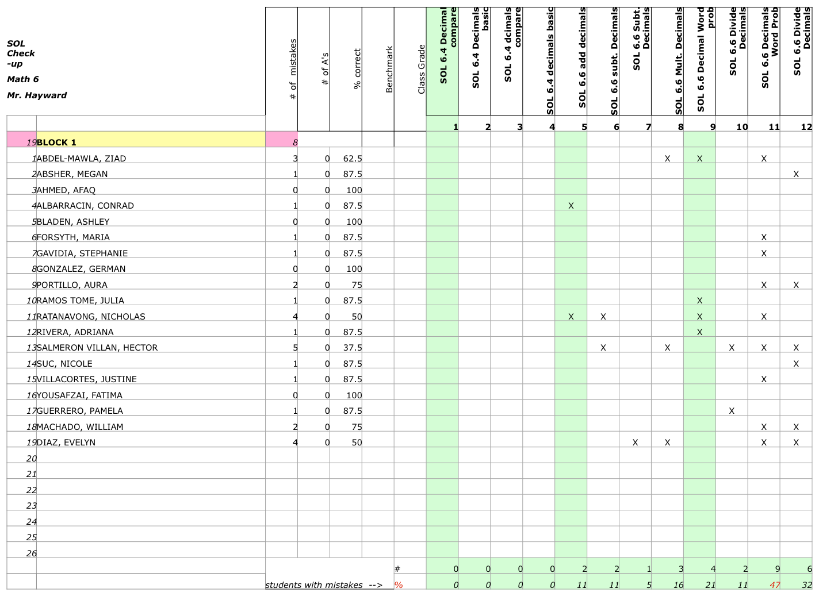

Slide 66
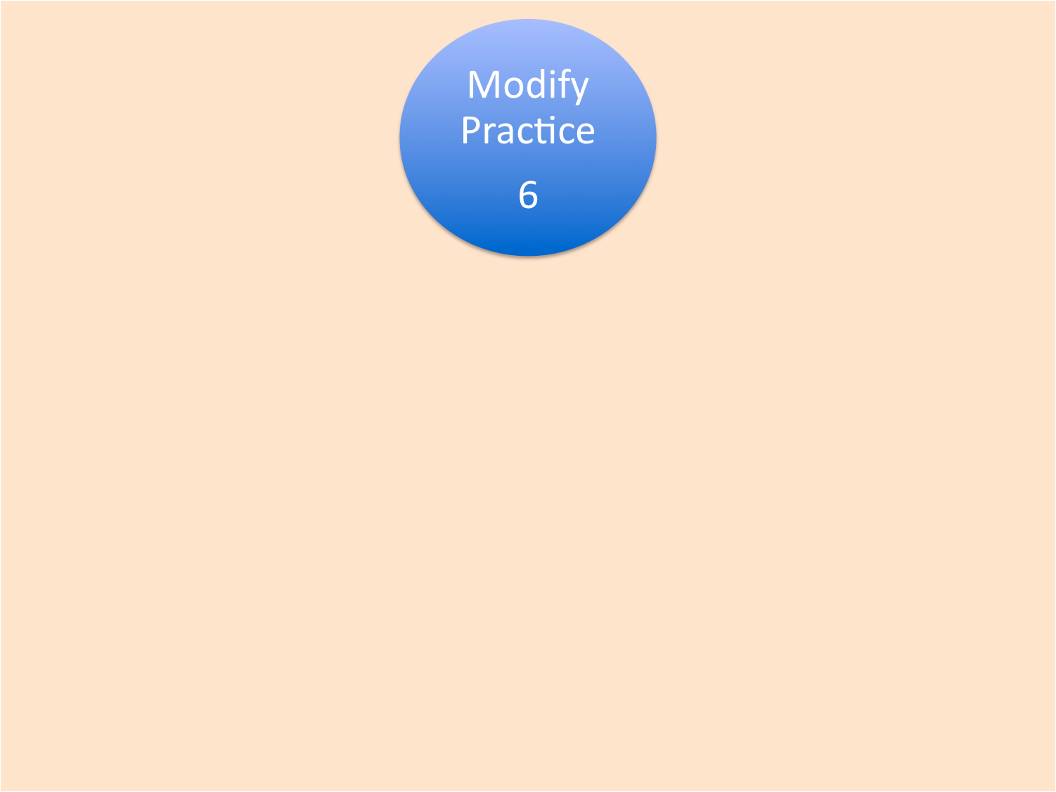
The Continuous
Improvement Process
Based on the collective analysis of multiple data points, teams of teachers determine a course of action to modify, differentiate and re-teach. This collaborative process can lead to expanding the breadth and scope of teaching strategies and techniques.
The Edwards Model© 2012

Slide 67
Resources
www.wallacefoundation.org/knowledge-center/school-leadership/key-research/Pages/How-Leadership- Influences-
Student-Learning.aspx articles on teacher quality
www.det.nsw.edu.au/proflearn/areas/qt/research.htm#5
www.learningandteaching.info/ collated research
course1.winona.edu/shatfield/air/rubrics.htm Rubrics

Slide 68
Questions/Comments? This Coming Year . . .

Slide 69
Thank You!

